Slide 1


Slide 2
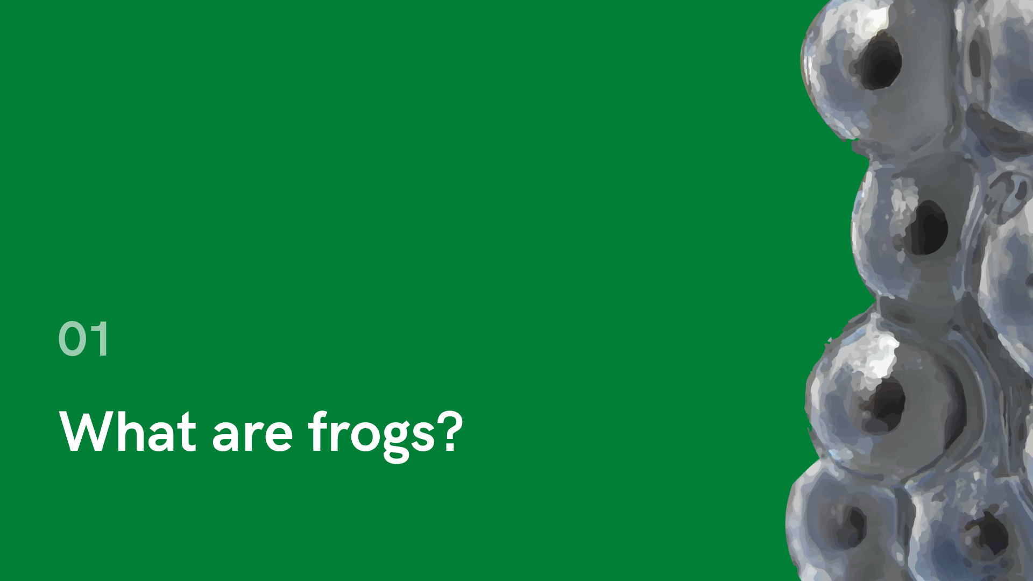

Slide 3
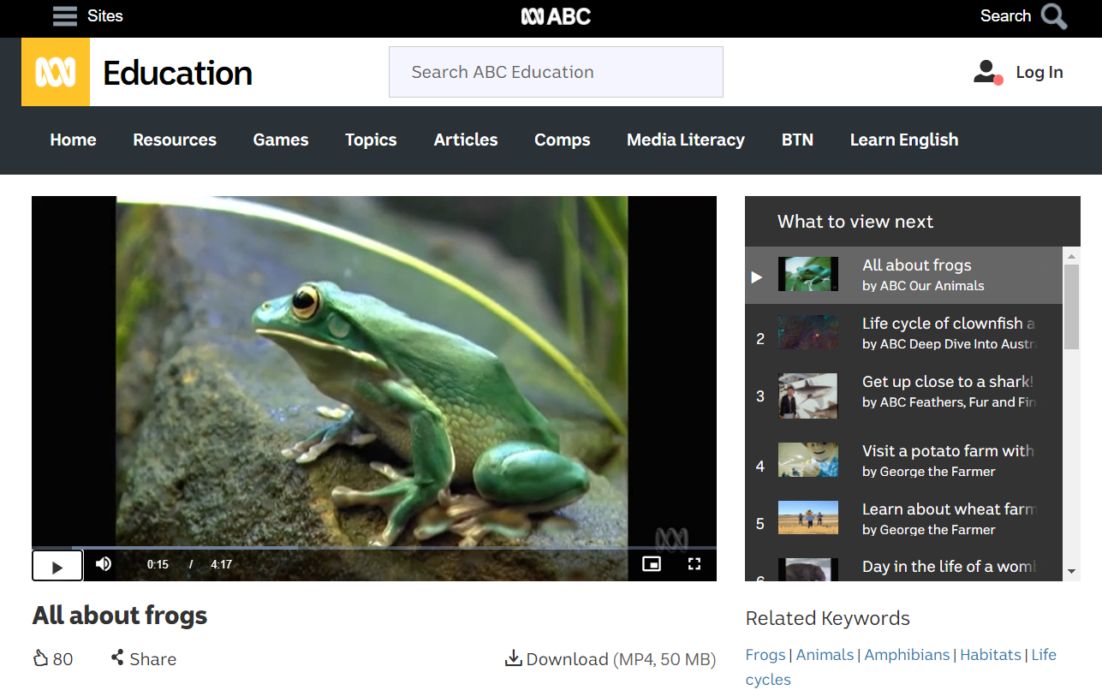
View the video

Slide 4

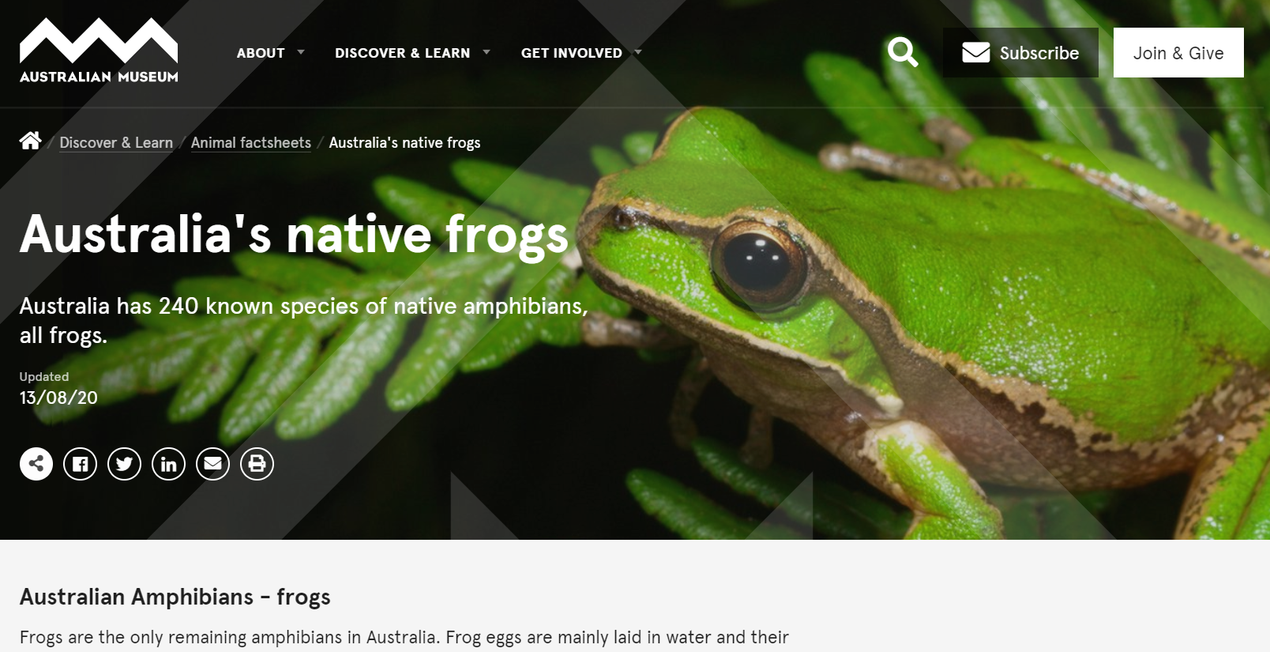
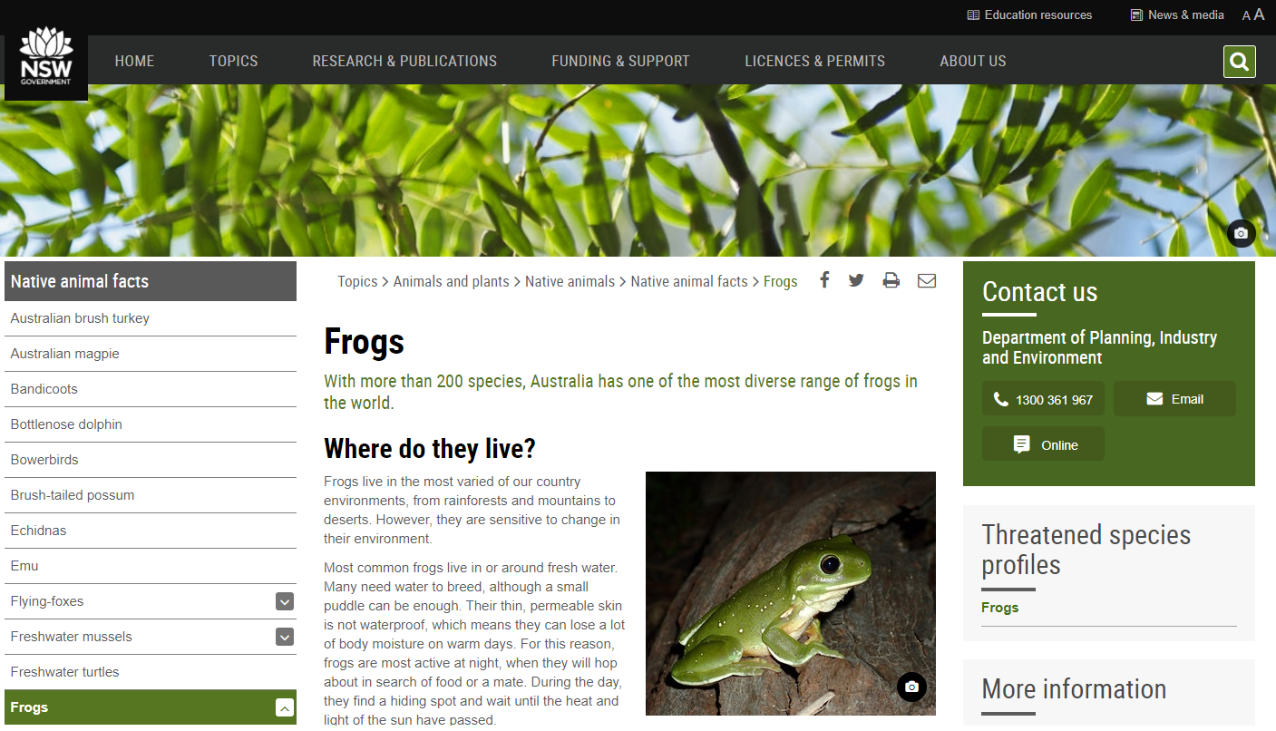
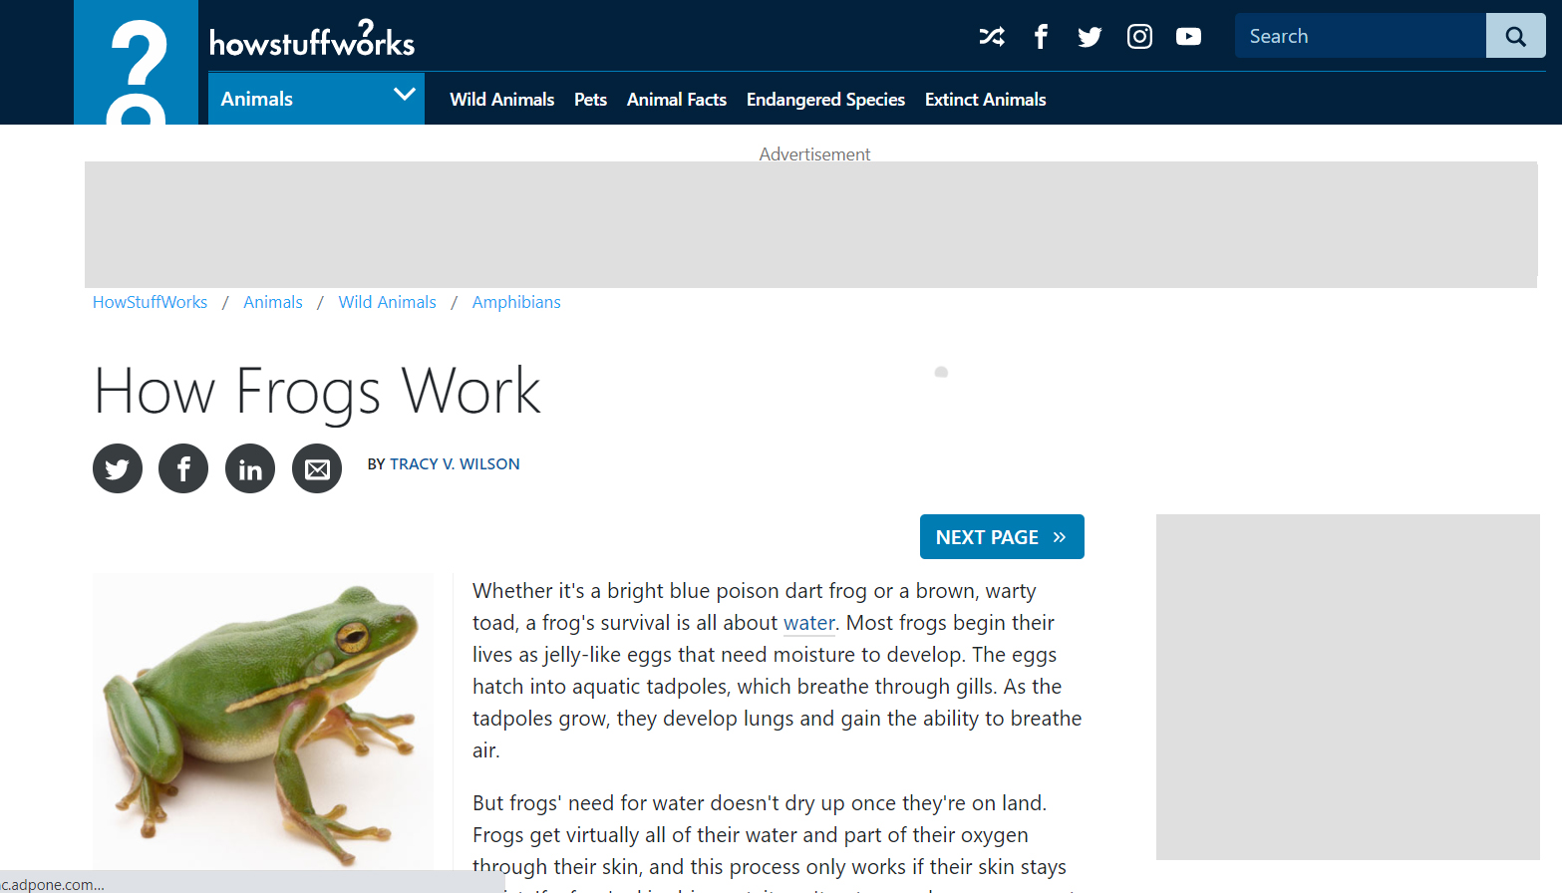
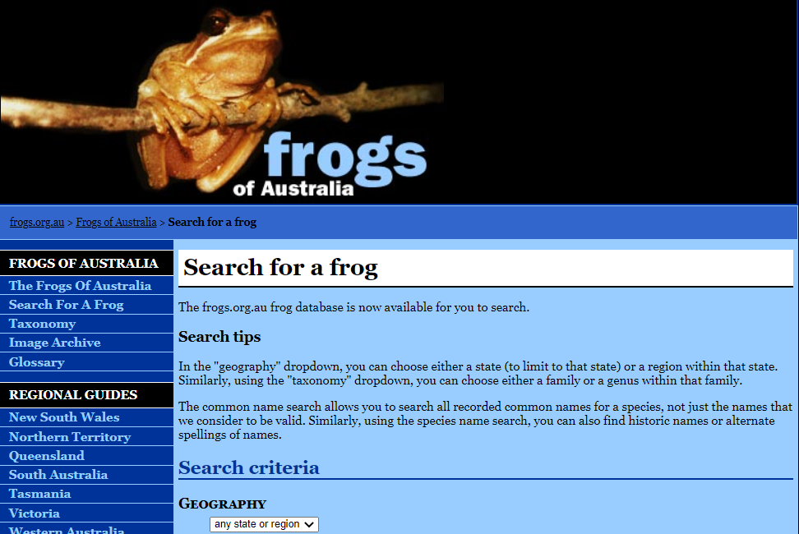
Websites for research:
The Australian Museum (https://australian.museum/learn/animals/frogs/)
NSW Department of Planning, Industry and Environment (https://www.environment.nsw.gov.au/topics/animals-and-plants/native-animals/native-animal-facts/frogs)
How Stuff Works (https://animals.howstuffworks.com/amphibians/frog.htm)
Frogs of Australia (https://frogs.org.au/frogs/search.php)

Slide 5
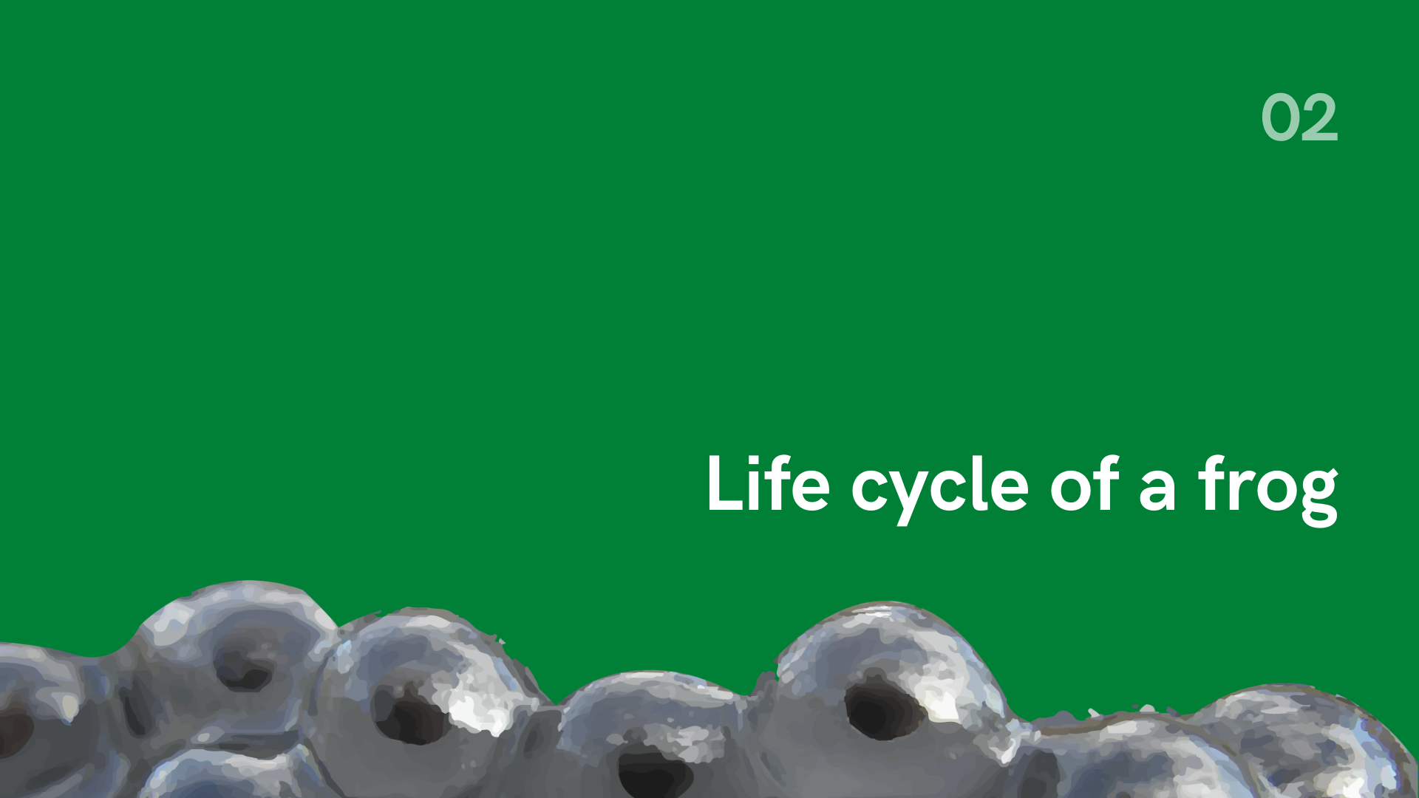

Slide 6

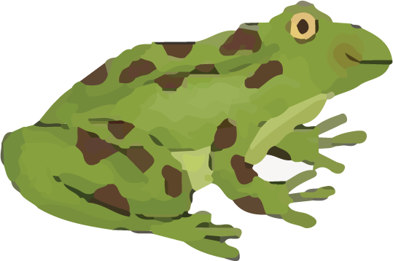
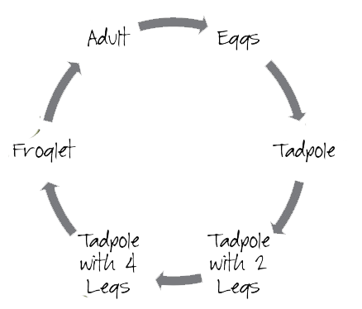
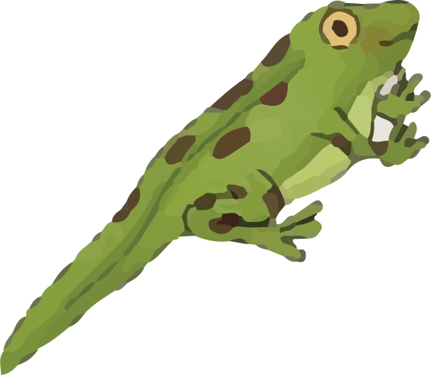
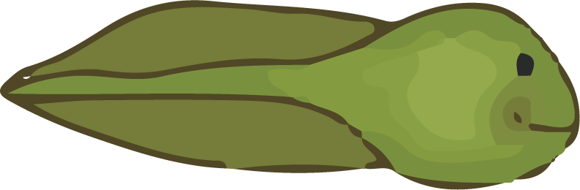
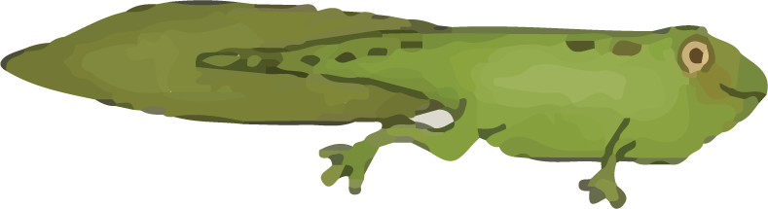
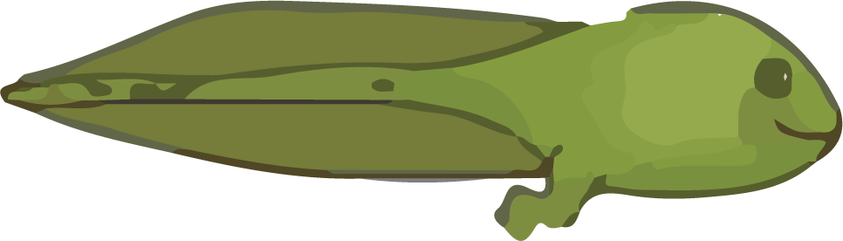
Life cycle of a frog
Image source: https://englishiscoolsite.wordpress.com/2016/11/21/frog-cycle/

Slide 7
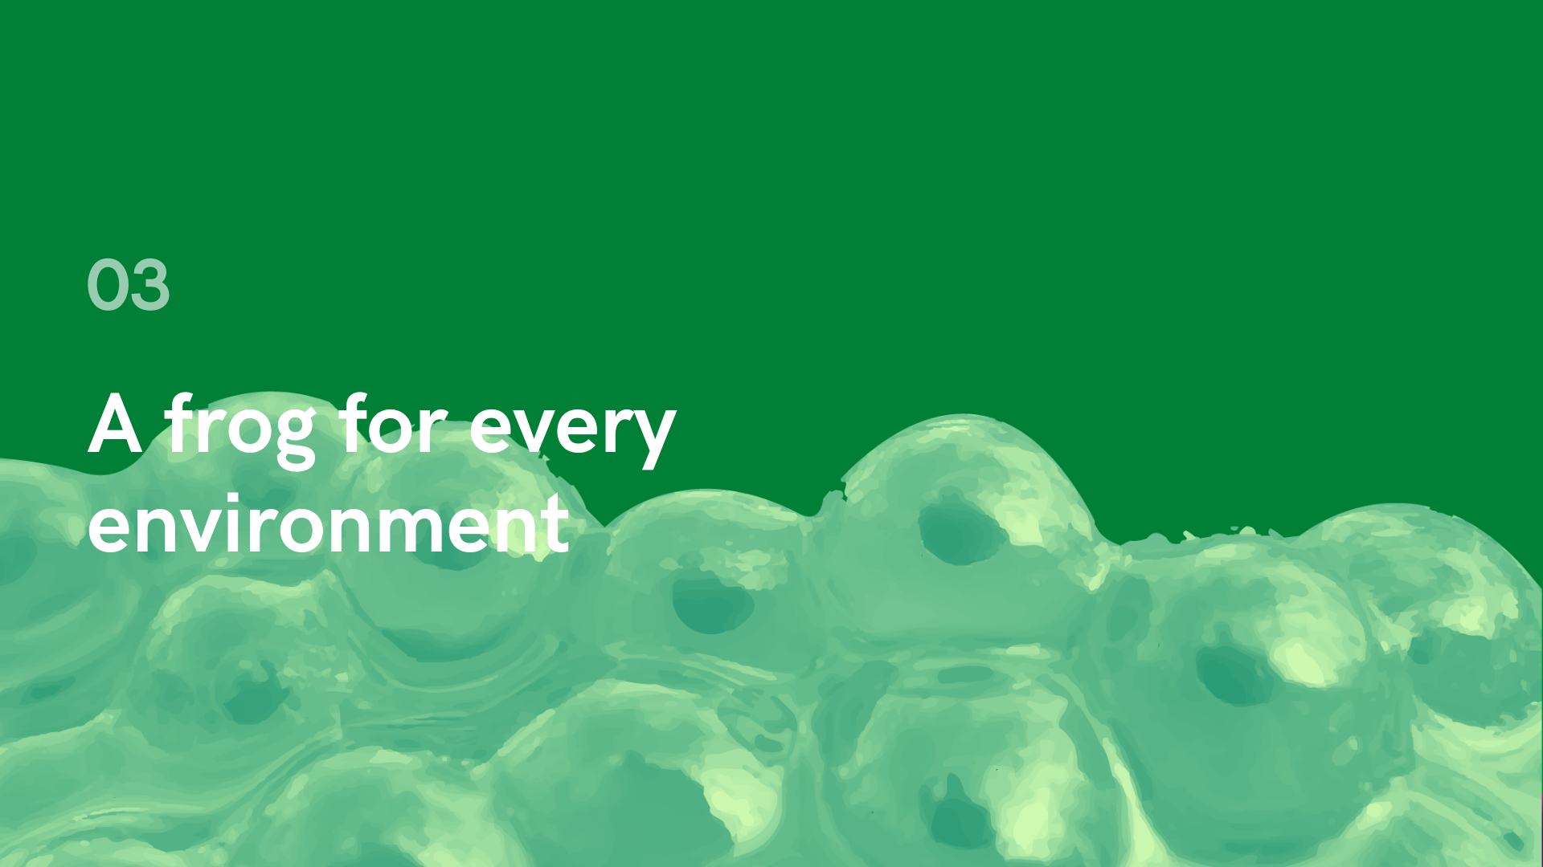

Slide 8
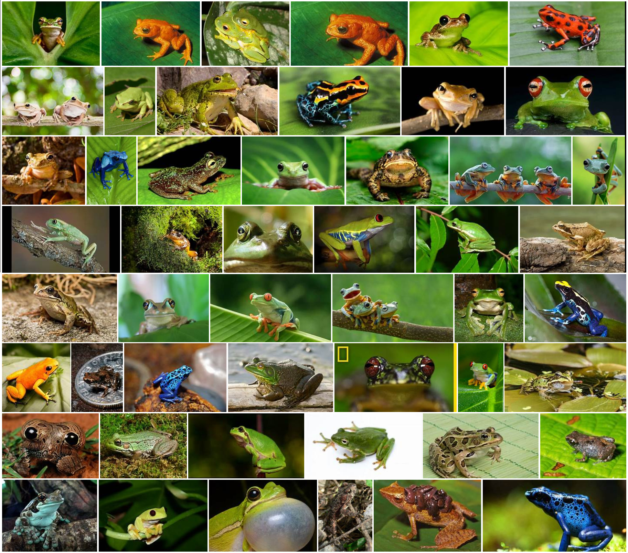

Slide 9

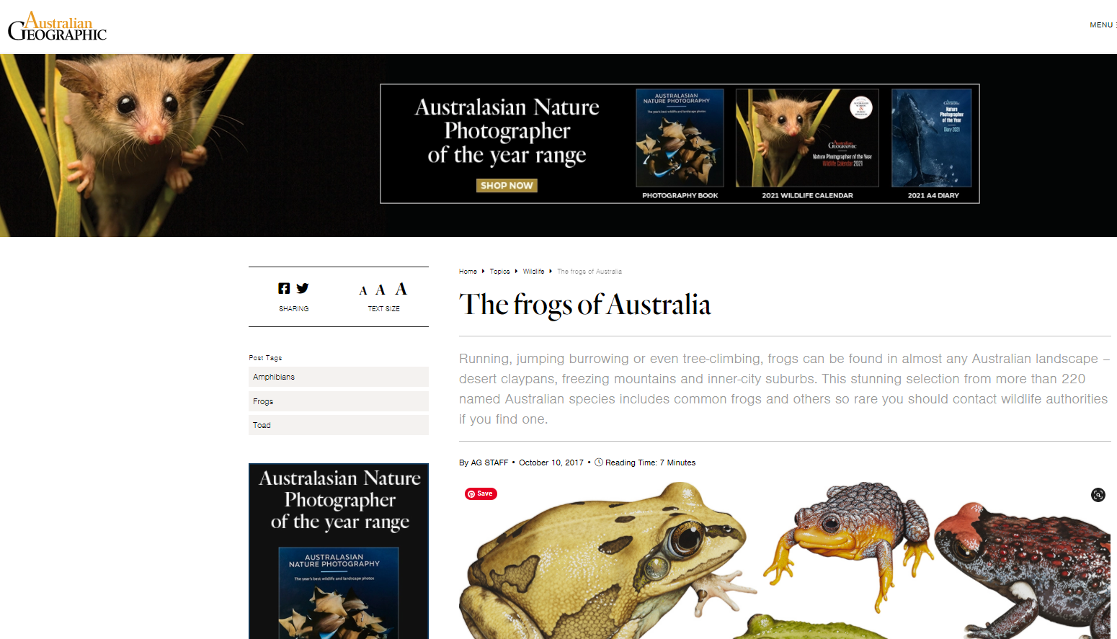
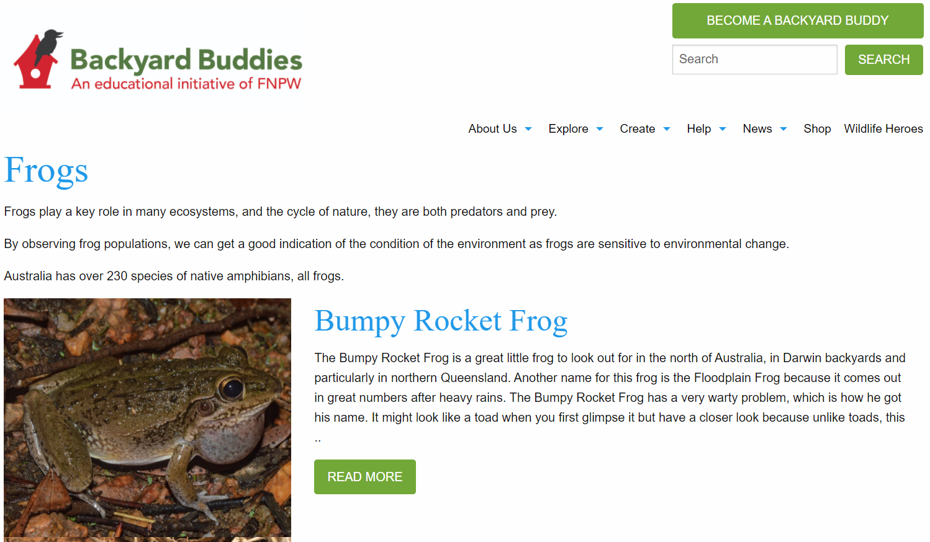
Websites for research:
NSW Department of Planning, Industry and Environment (https://www.environment.nsw.gov.au/topics/animals-and-plants/native-animals/native-animal-facts/frogs)
Australian Geographic
https://www.australiangeographic.com.au/topics/wildlife/2017/10/australian-frogs/
Backyard Buddies (https://www.backyardbuddies.org.au/explore/frogs)
The Australian Museum (https://australian.museum/learn/animals/frogs/)

Slide 10
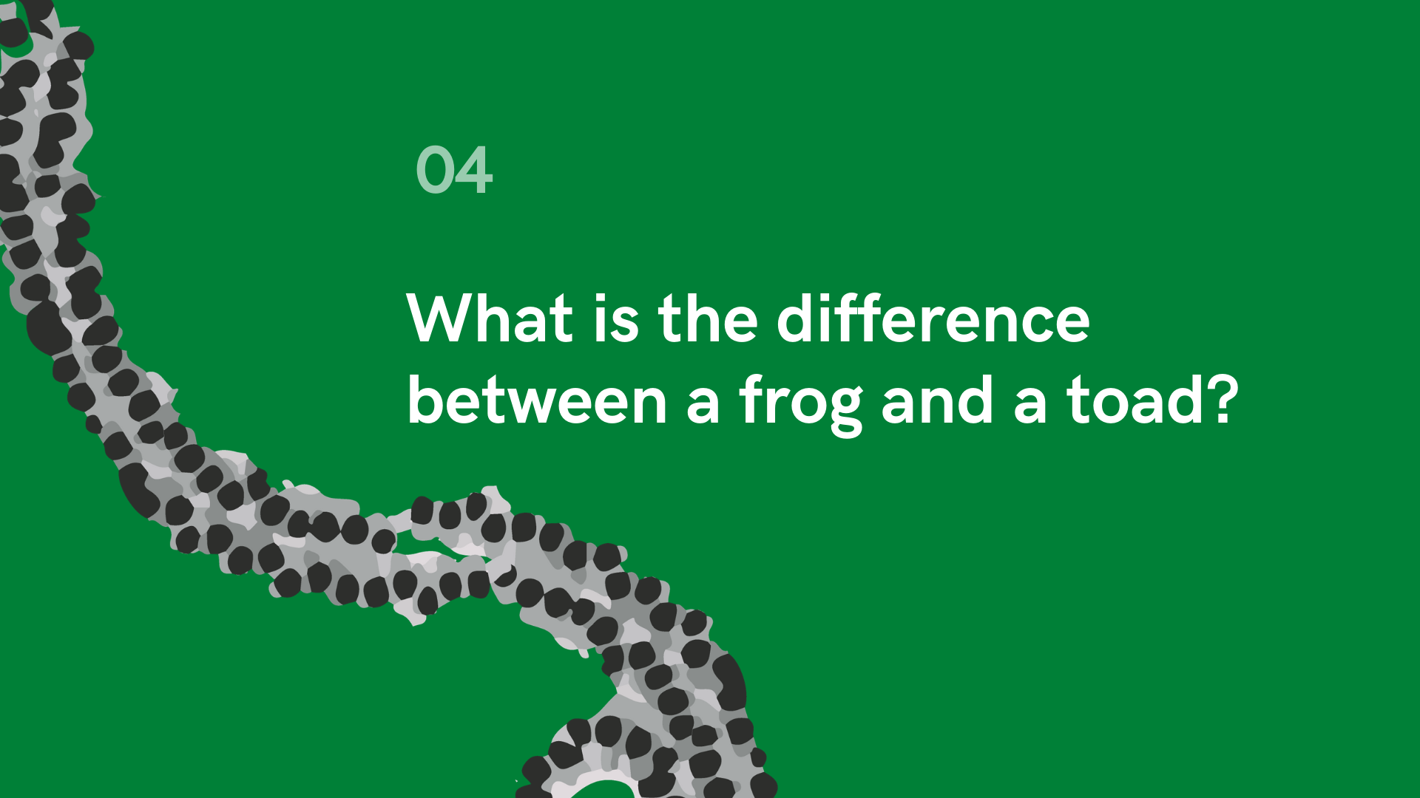

Slide 11
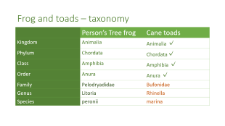
Frog or Toad?
Frogs and toads look similar
They are distantly related but not the same thing
They are both amphibians (a group of vertebrate animals who can inhabit both aquatic and terrestrial habitats*).
    Vertebrate – has a backbone or spinal chord
    Aquatic - water
    Terrestrial - land
Australia has no native toads and over 200 species of native frogs
Click on the image to see the classification difference between a native Peron’s Tree frog and a cane toad or skip.
*https://www.britannica.com/animal/amphibian

Slide 12
Frog and toads – taxonomy
 | Person’s Tree frog | Cane toads
Kingdom | Animalia | Animalia ✓
Phylum | Chordata | Chordata✓
Class | Amphibia | Amphibia ✓
Order | Anura | Anura ✓
Family | Pelodryadidae | Bufonidae
Genus | Litoria | Rhinella
Species | peronii | marina

Slide 13
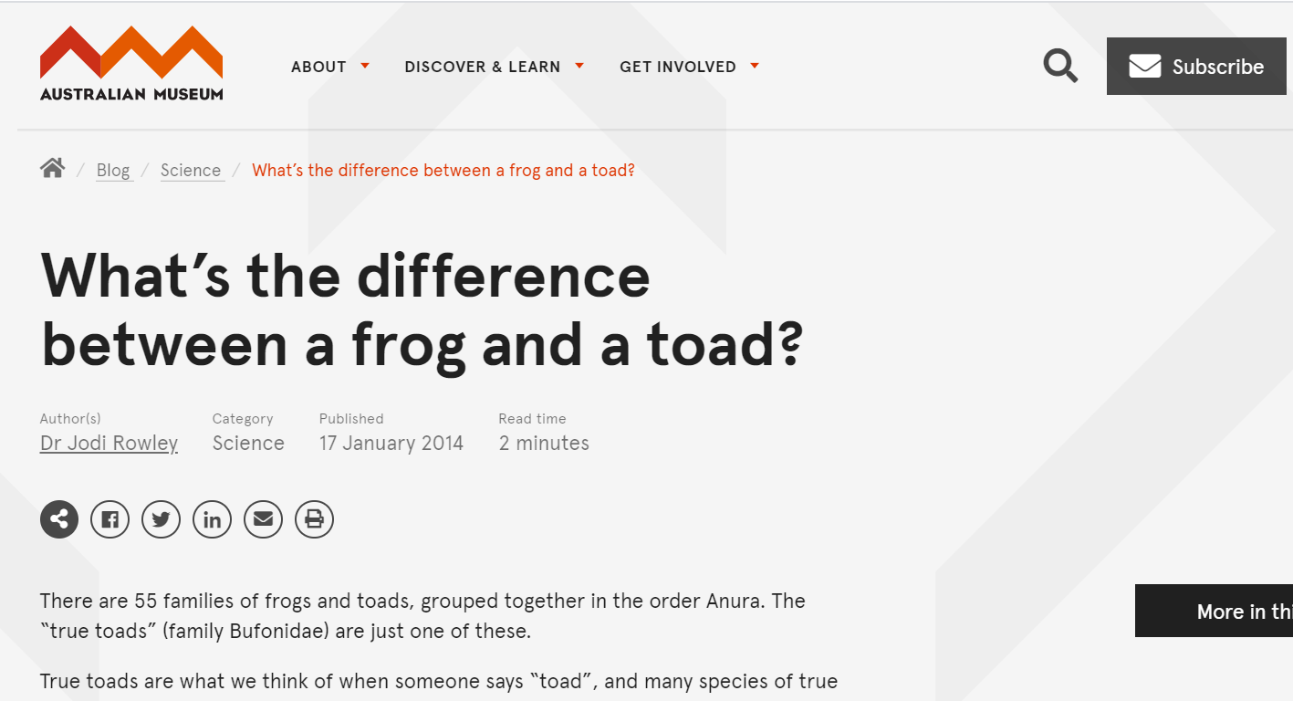
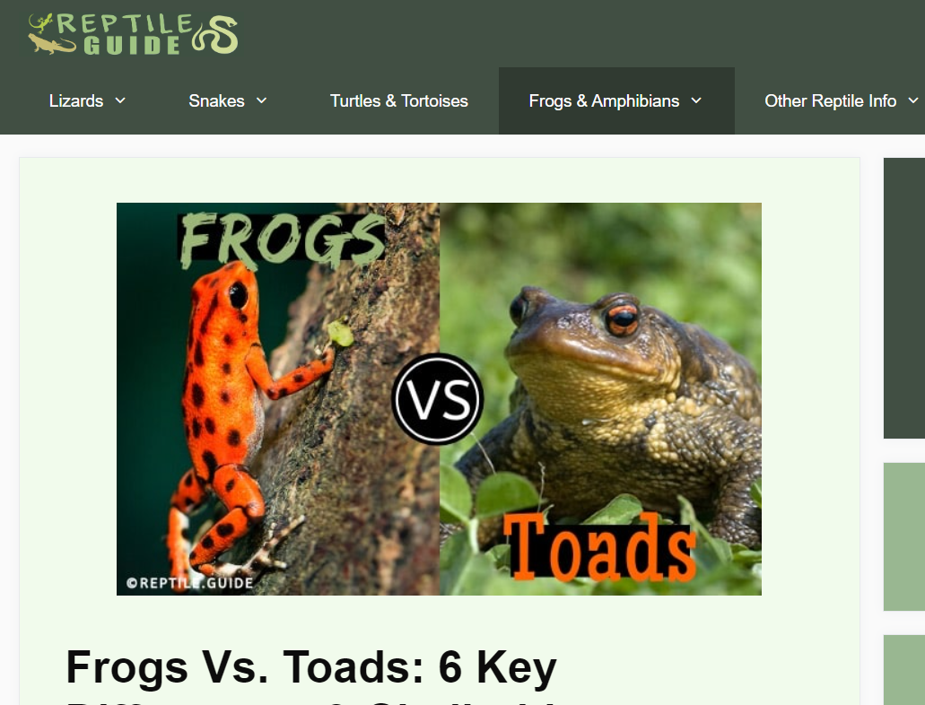
View the Australian Museum website
https://australian.museum/blog-archive/science/frogs-and-toads/
https://reptile.guide/frogs-vs-toads/

Slide 14
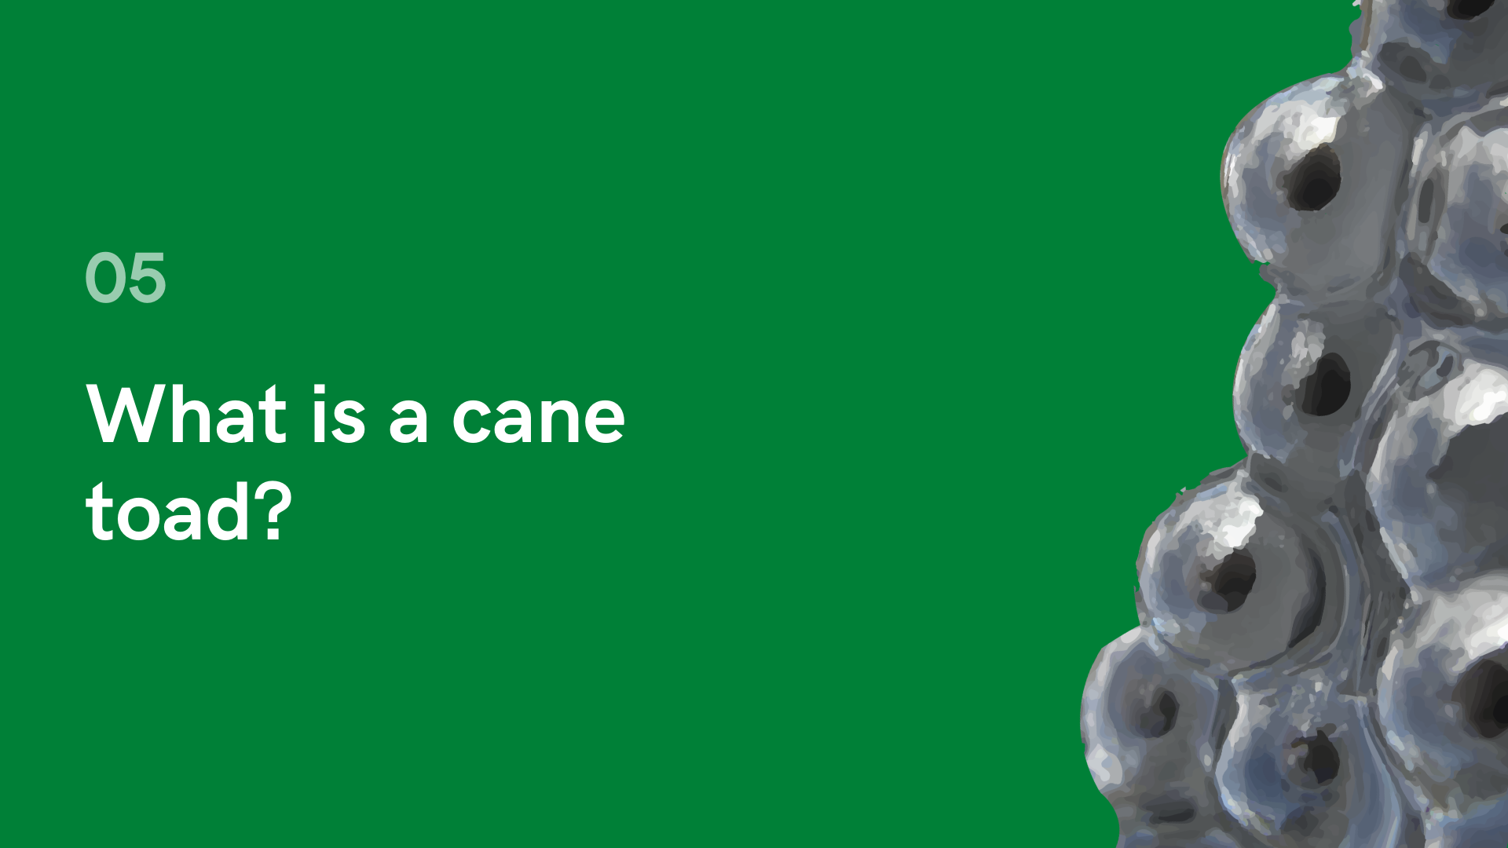

Slide 15
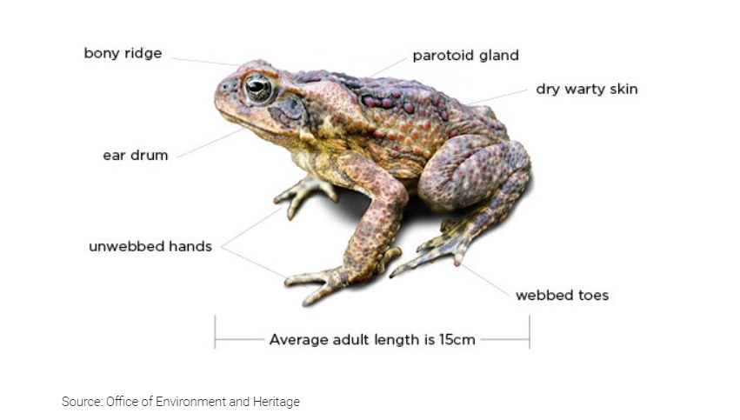
Distinctive features of cane toads

Slide 16
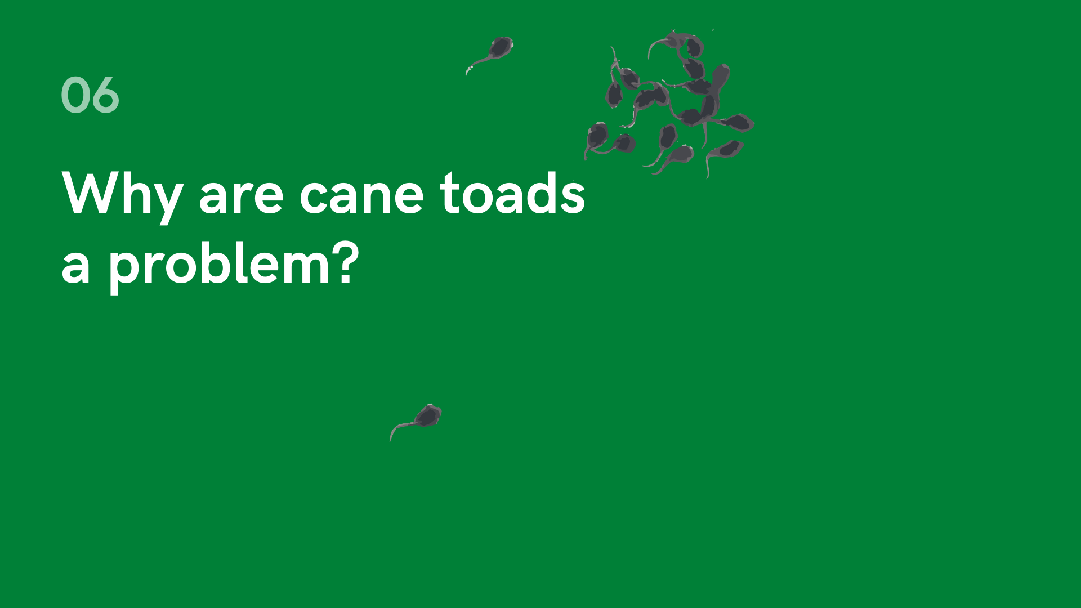

Slide 17
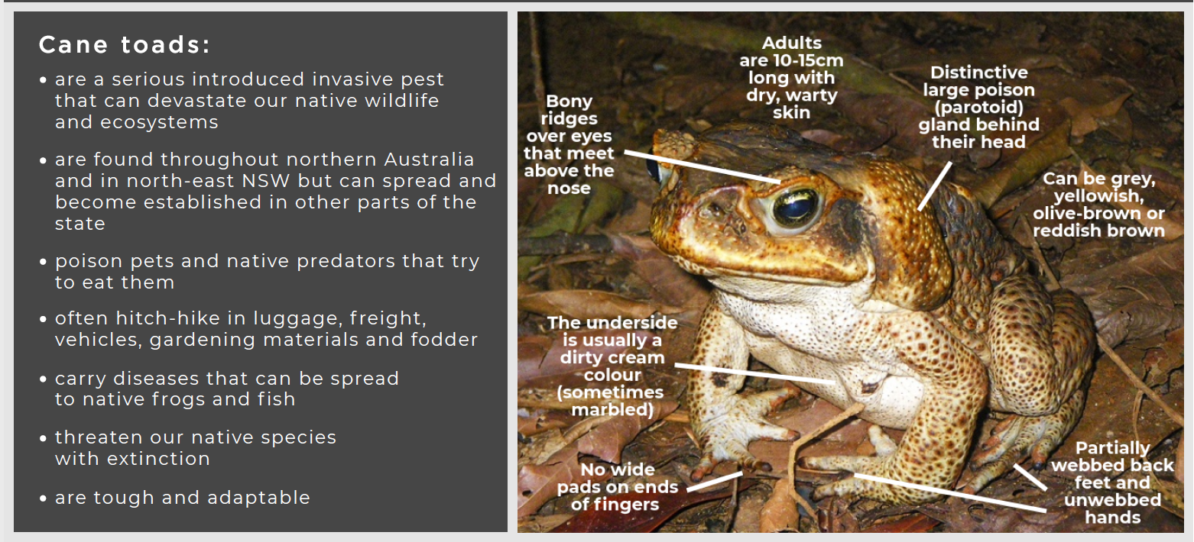
Source: https://nswfoodauthority.app.box.com/s/z1yuw3616xw77enqemj8wj6k1cktzyoi

Slide 18
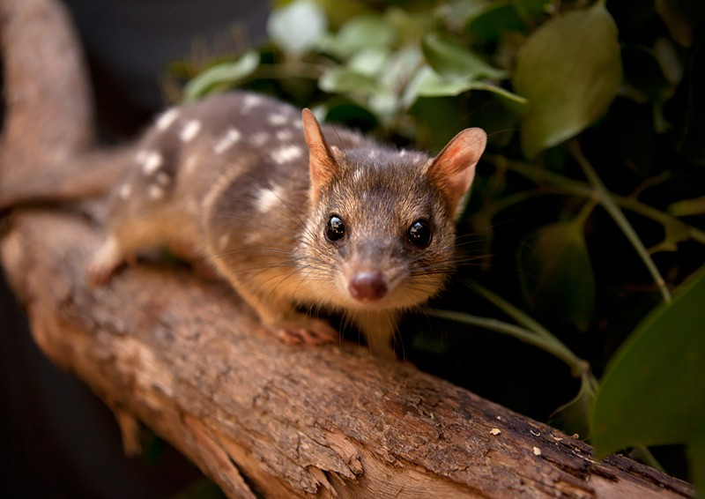
That means…
Native animals and pets that eat cane toads can be poisoned
Cane toads eat the eggs and babies of native frogs and small animals
They reproduce in huge numbers
They can quickly take over pools of water that native frogs and other animals live
Cane toads have been linked with the local extinctions of some native snakes and the Northern Quoll

Slide 19
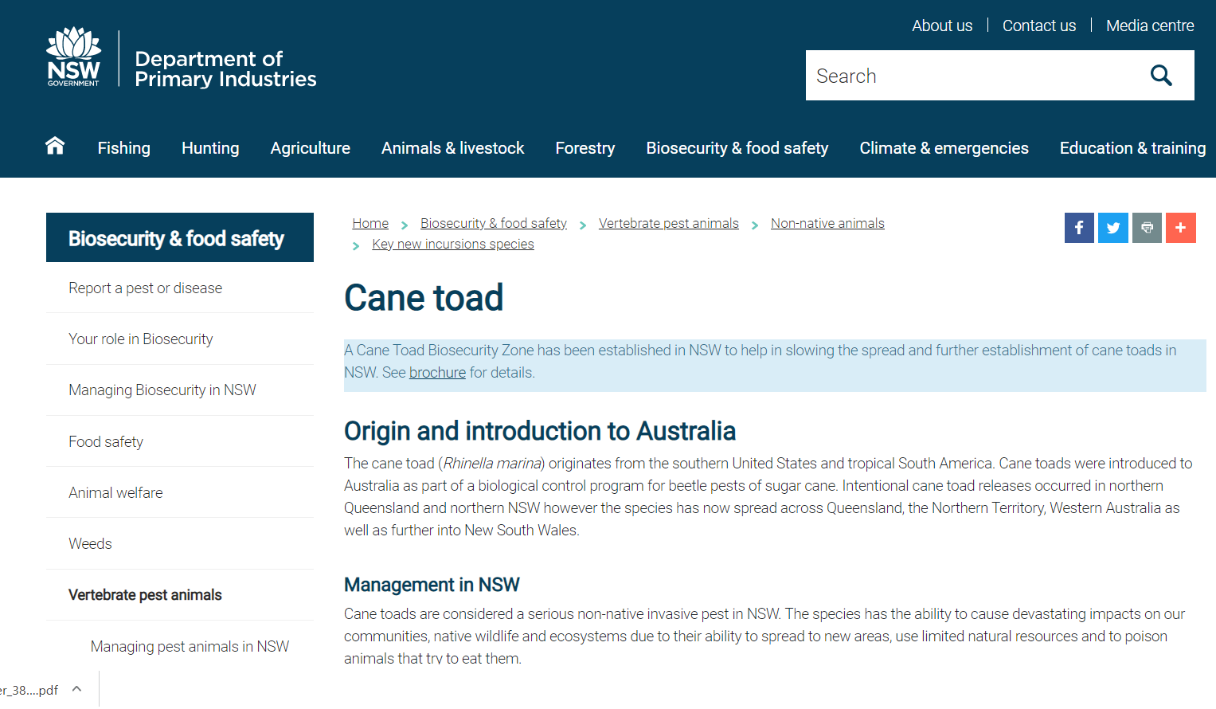
Click to visit the NSW Department of Primary Industries website to assist with the close activity:
https://www.dpi.nsw.gov.au/biosecurity/vertebrate-pests/nia/key-new-incursions-species/new-incursions/cane-toad

Slide 20
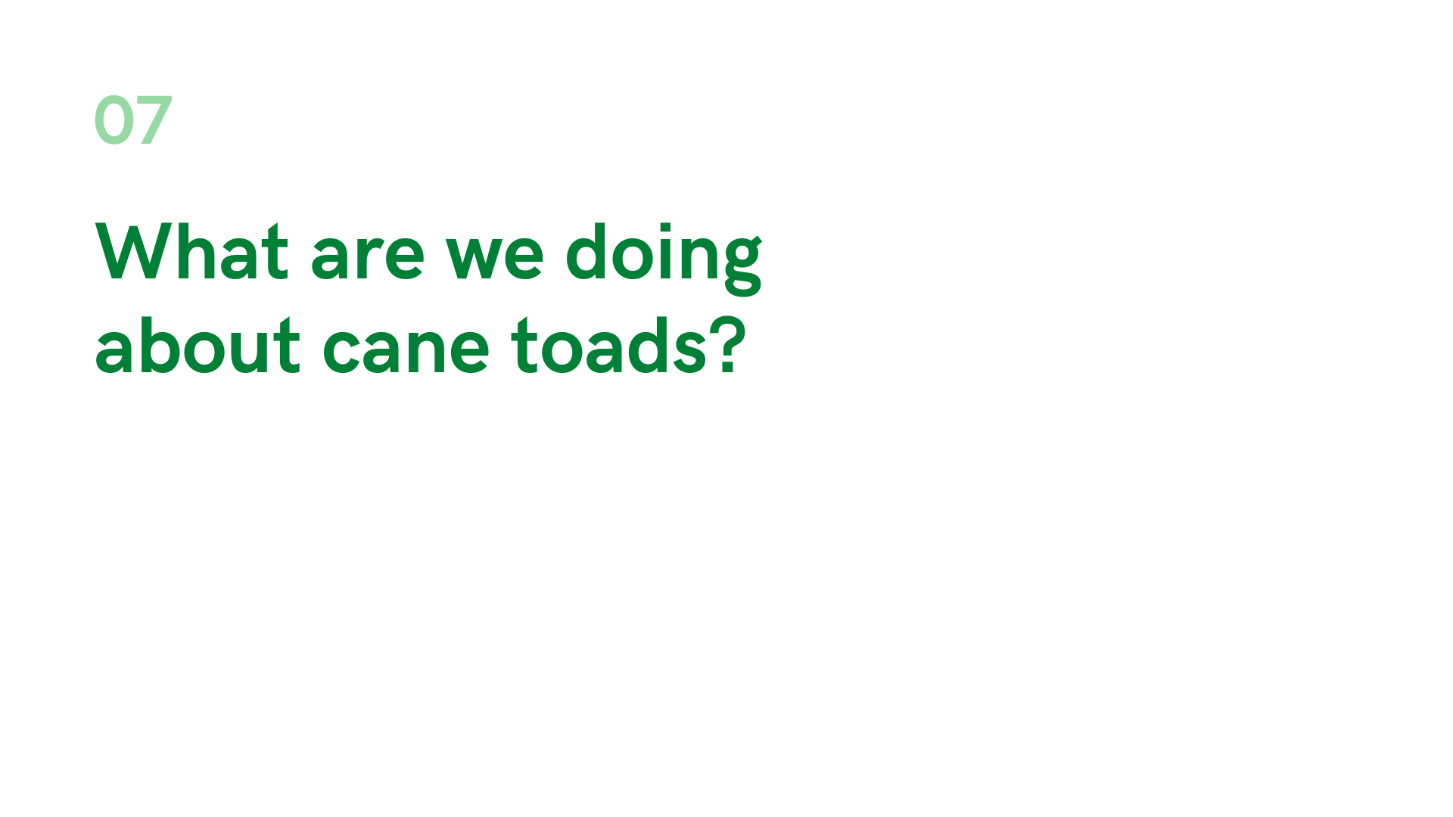


Slide 21
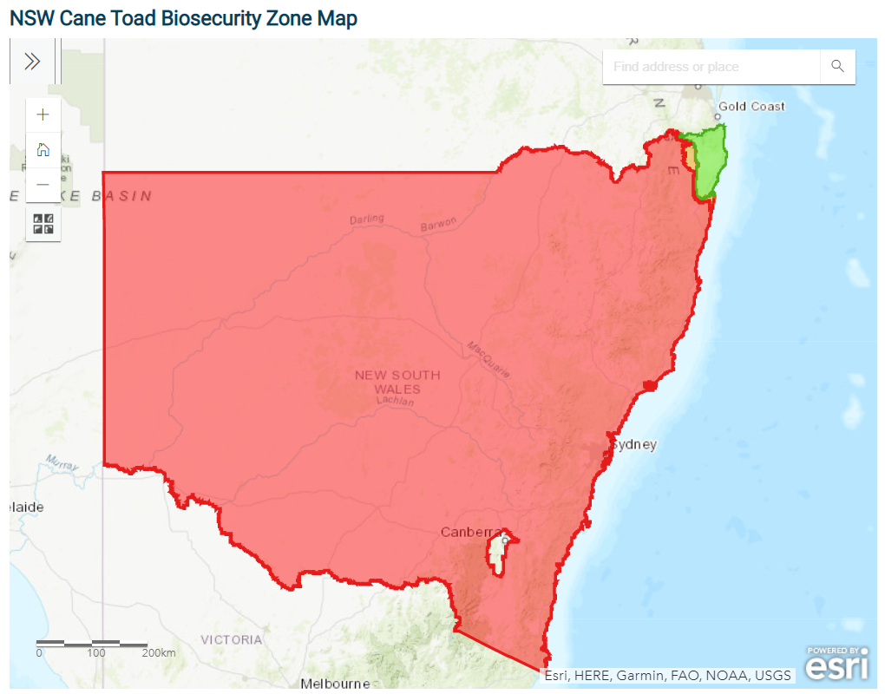
The NSW DPI website advises that there is no broadscale method to control the cane toad. Maintaining awareness of cane toads, reporting their presence and managing them responsibly when detected will help in slowing the spread and further establishment of cane toads in NSW.
When cane toads are reported…

Slide 22
When cane toads are reported in the Biosecurity Zone in New South Wales and the sighting is confirmed the animal is taken to a veterinarian and euthanized. From there:
Gender
The gender is determined, if it is a female the vet can tell if it:
Risk
The risk posed by the incursion is based on…
If the toad is female:
Number of animals found (one individual is lower risk than more than one) and
Gender - males are a lower risk than females who may be carrying eggs or have just laid some.
Is she reproductively mature?
Does she have eggs?
Is there evidence of previous breeding?
Has she recently laid eggs?
Action
Is reproductively mature,
has eggs ready to lay or
recently laid eggs (of 30,000 or so eggs there are always some left in the ovaries).
Next steps…

Slide 23
Action
If there is only one animal NSW DPI investigate and tries to determine a vector for the animal – how did it get here? Often they have hitched ride on vehicles or landscaping and building materials
If there is more than one or evidence that she recently laid eggs DPI liaise with groups in the area including Local Land Services to undertake active surveillance (spotlight nights, call recording, looking in waterbodies for egg strings). If more toads are found an attempt is made to eradicate them.
The community are encouraged to get involved in surveillance with letterbox drops and through the media.

Slide 24
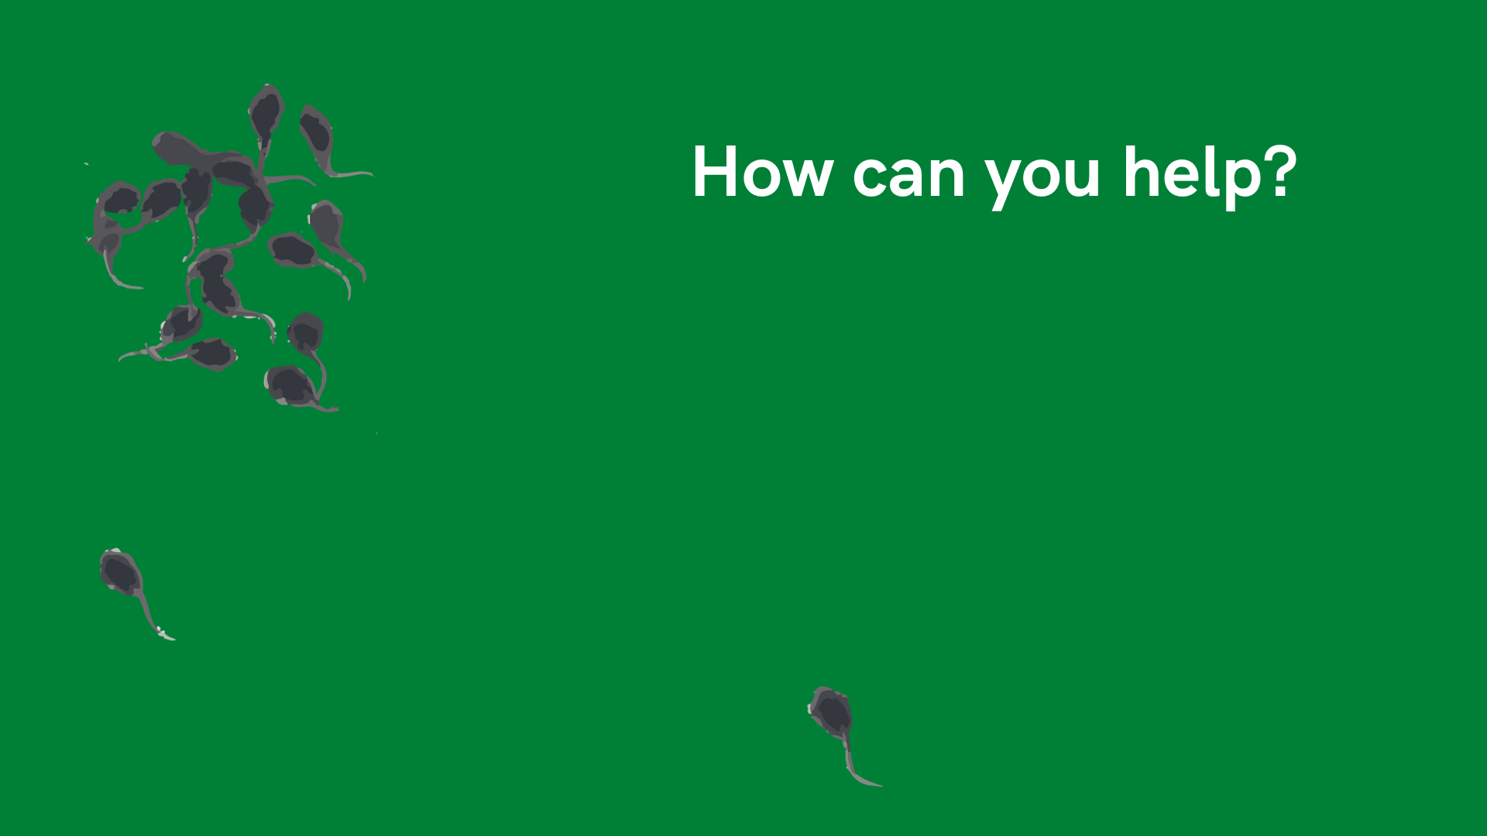

Slide 25
The Cane Toad Biosecurity Zone incorporates all areas of NSW except a portion of the north east of the state where surveys indicate that cane toads have established endemic populations.
If you see a cane toad in any area of NSW outside the green zone the Department of Primary Industries want to know where you saw it.

Slide 26
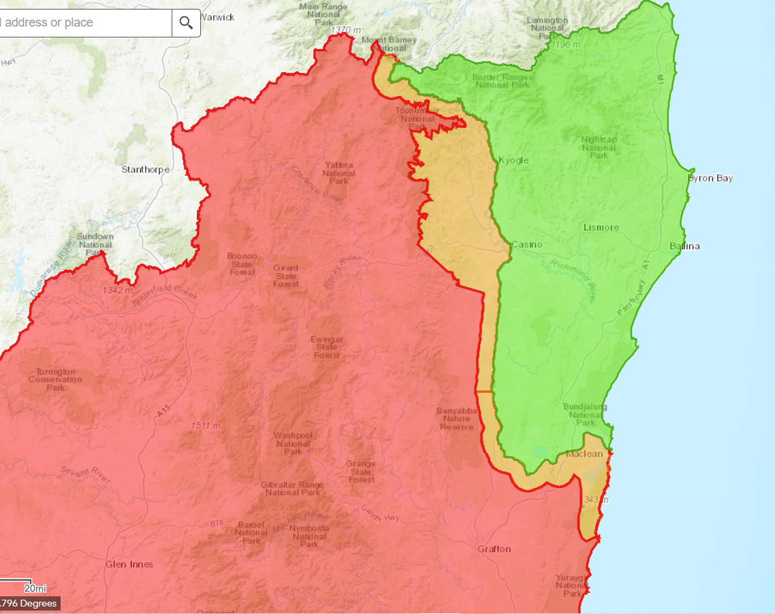
Woodenbong
Kyogle
Casino
Maclean
Current September 2020

Slide 27
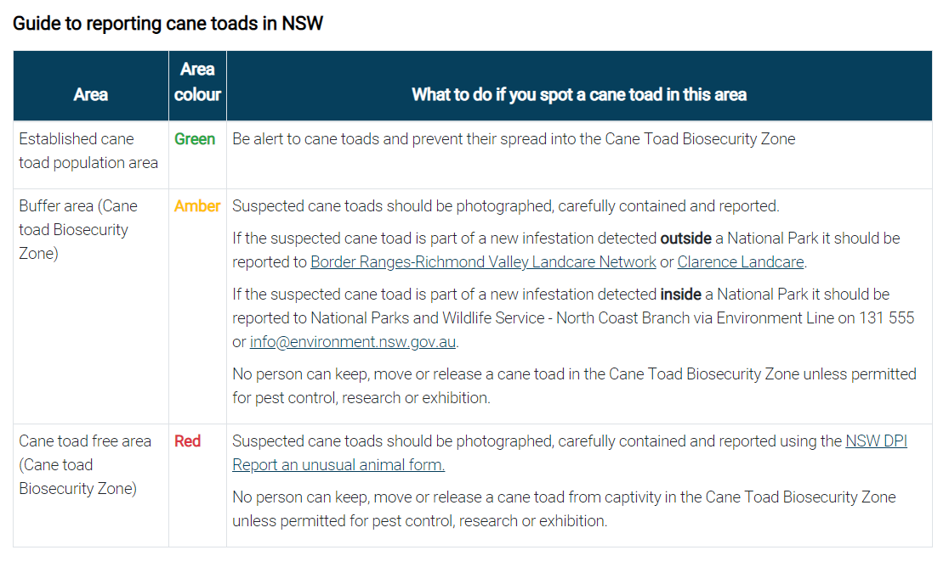

Slide 28
If you think you have seen a cane toad:
Catch it:
Don’t harm it - it might actually be a native frog
Wear protective clothing such as disposable gloves, glasses, long sleeves and eye protection before touching it
Watch out for poison. When stressed, cane toads can ooze and sometimes squirt poison from glands behind the head
If you can do so safely, keep it in a well-ventilated container with a little water in a cool location while we determine the species

Slide 29
Report it:
Take a photo (if you can)
Record your location
Report the detection to
www.dpi.nsw.gov.au/biosecurity/sighting

Slide 30
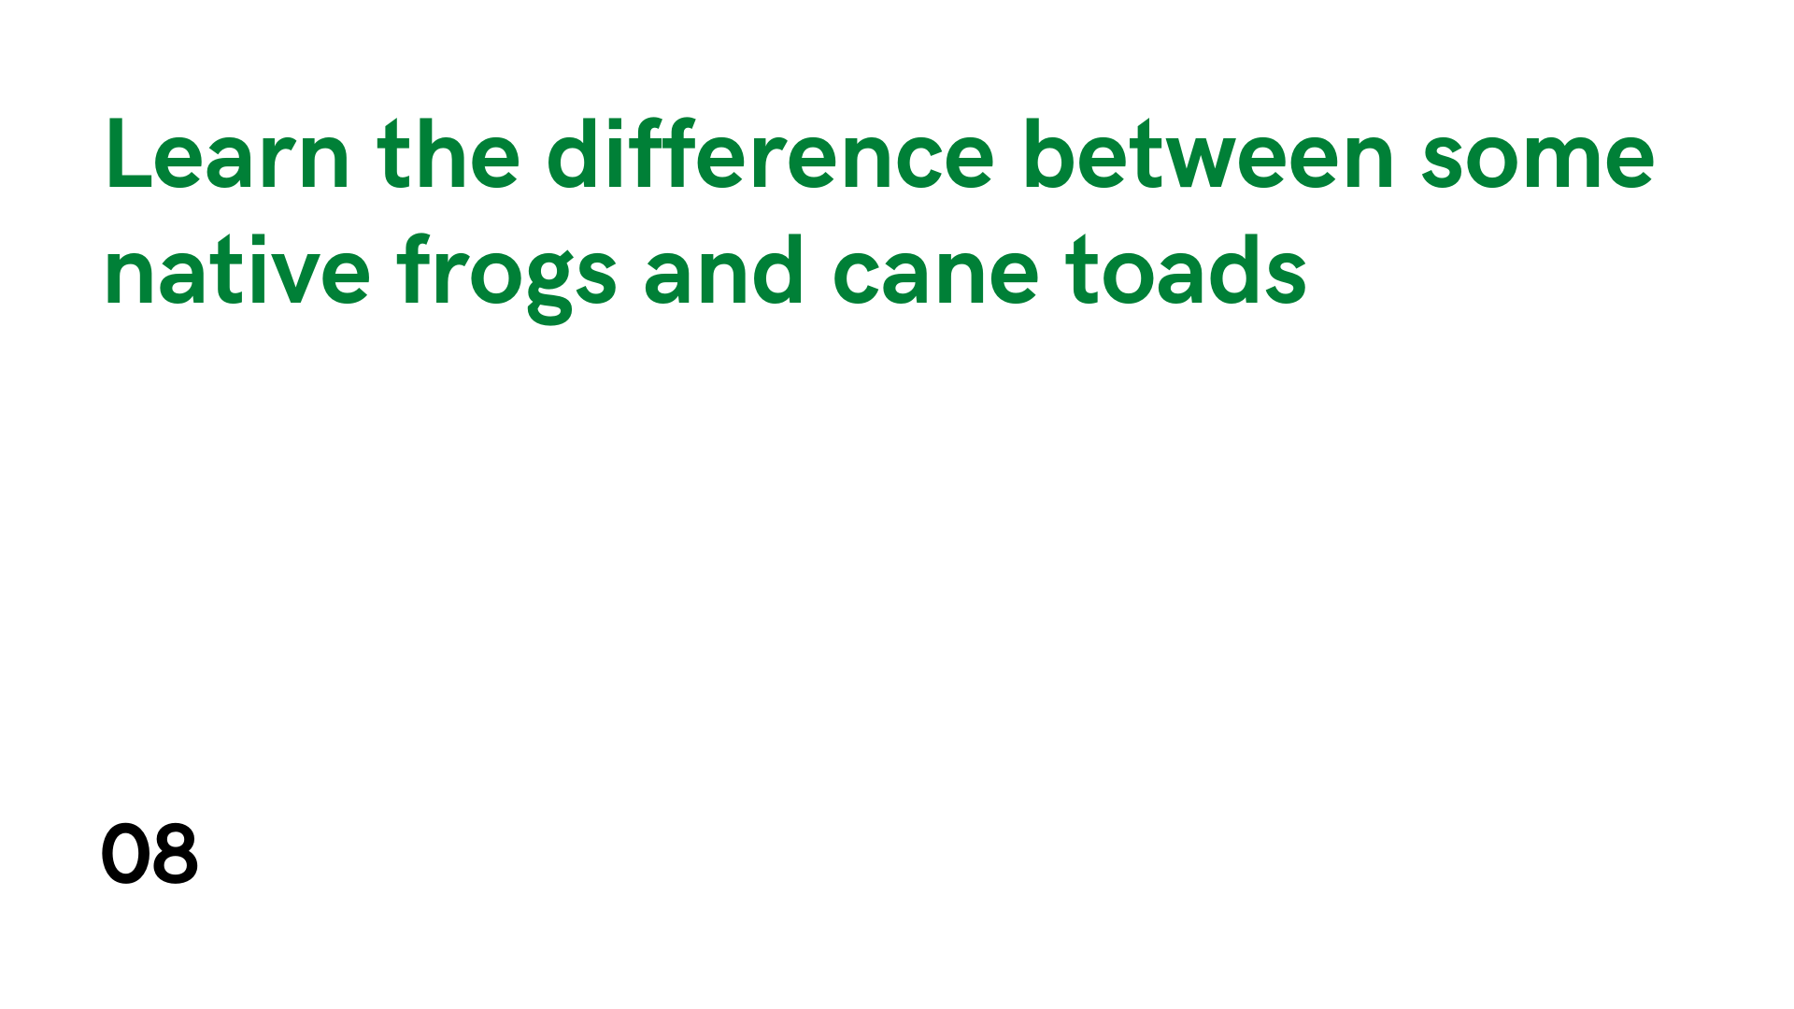

Slide 31
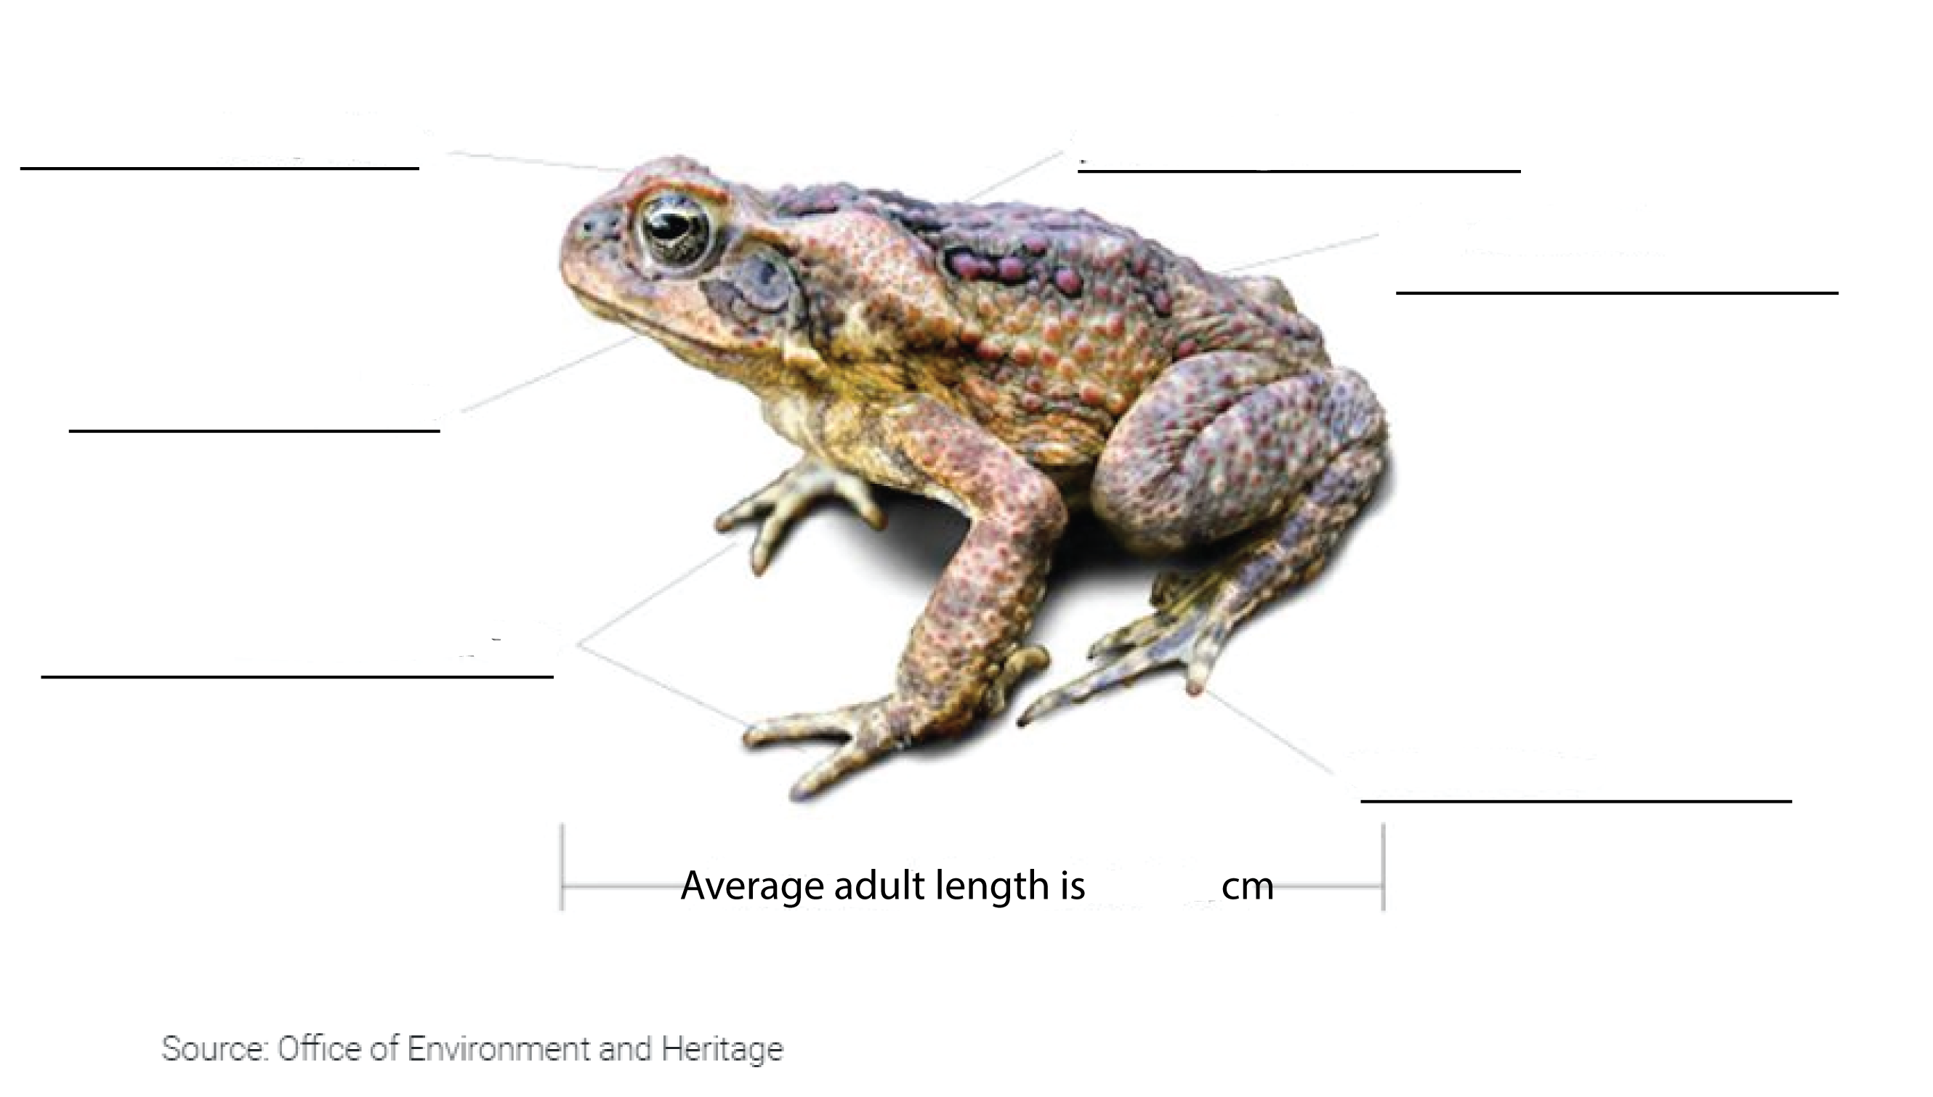
Features of cane toads
Appearance: large heavily-built amphibians
adult cane toads have large swellings - the parotoid glands - on each shoulder behind the eardrum
bony head bony ridges that meet above the nose.
young cane toads have a smooth dark skin with darker blotches and bars, and lack conspicuous parotoid glands
may be grey, yellowish, olive-brown or reddish-brown, and their bellies are pale with dark mottling
front feet are unwebbed
hind feet have leathery webbing between the toes
10-15

Slide 32
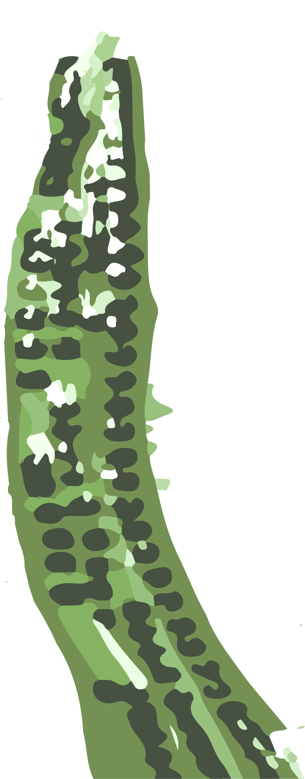
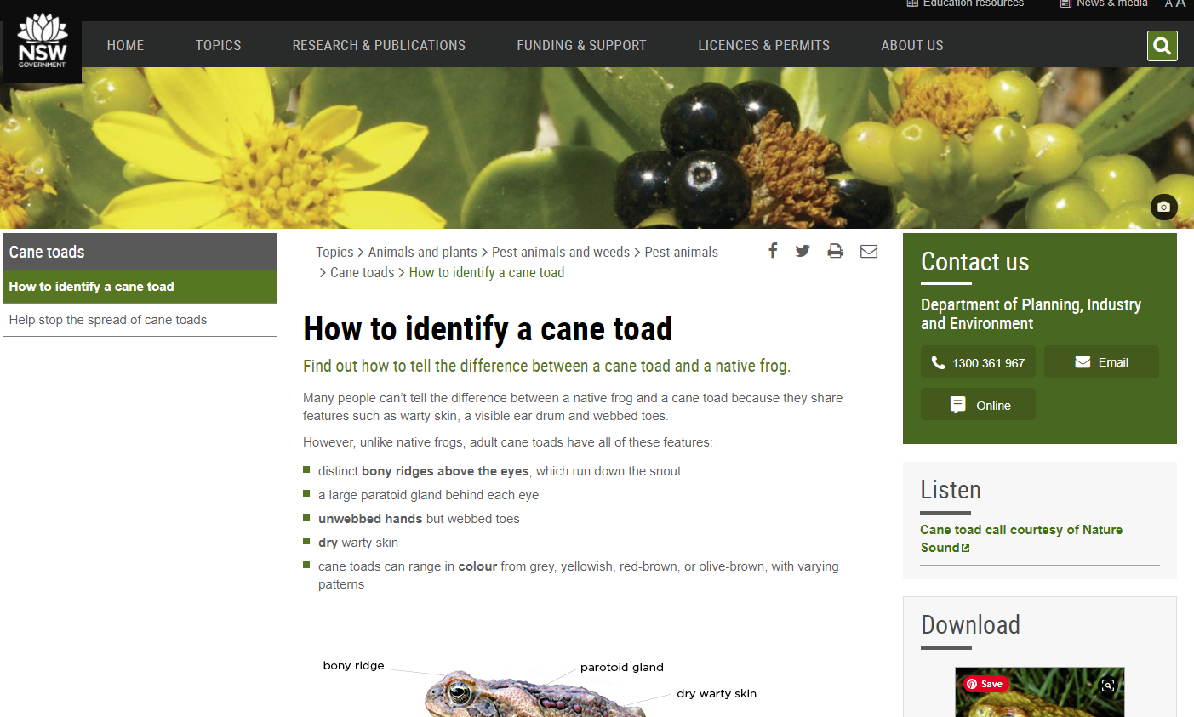
Features of cane toads (cont)
Behaviour
sit upright and move in short rapid hops
mating call is a long loud purring trill.
Hear the cane toad on the Australian Museum Frog ID app and on the NSW Department of Planning, Industry and Environment (click the image)

Slide 33
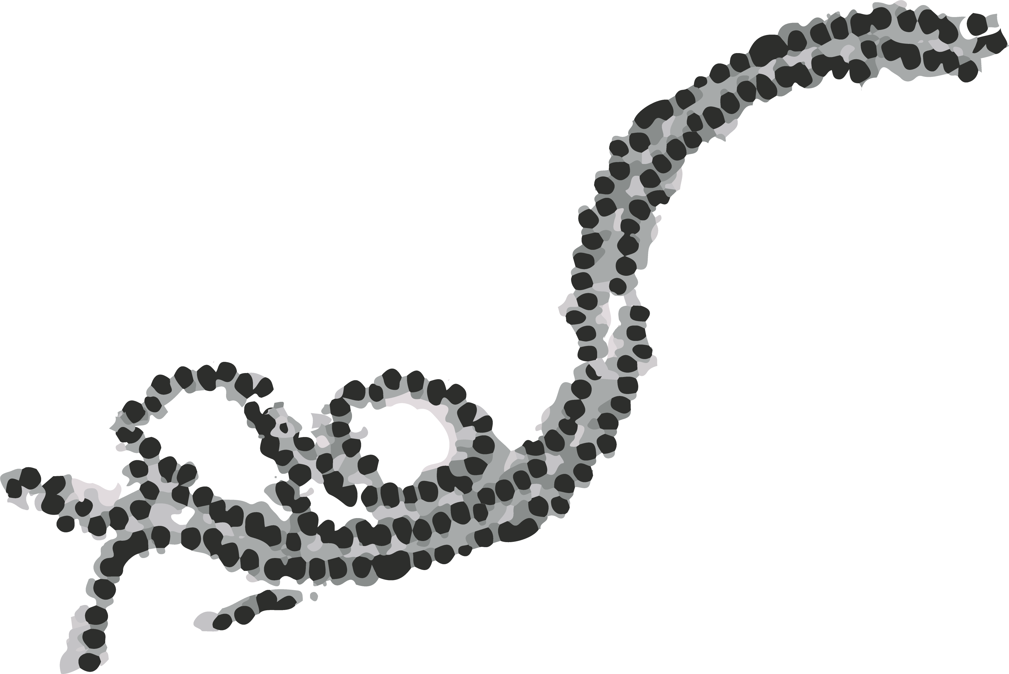
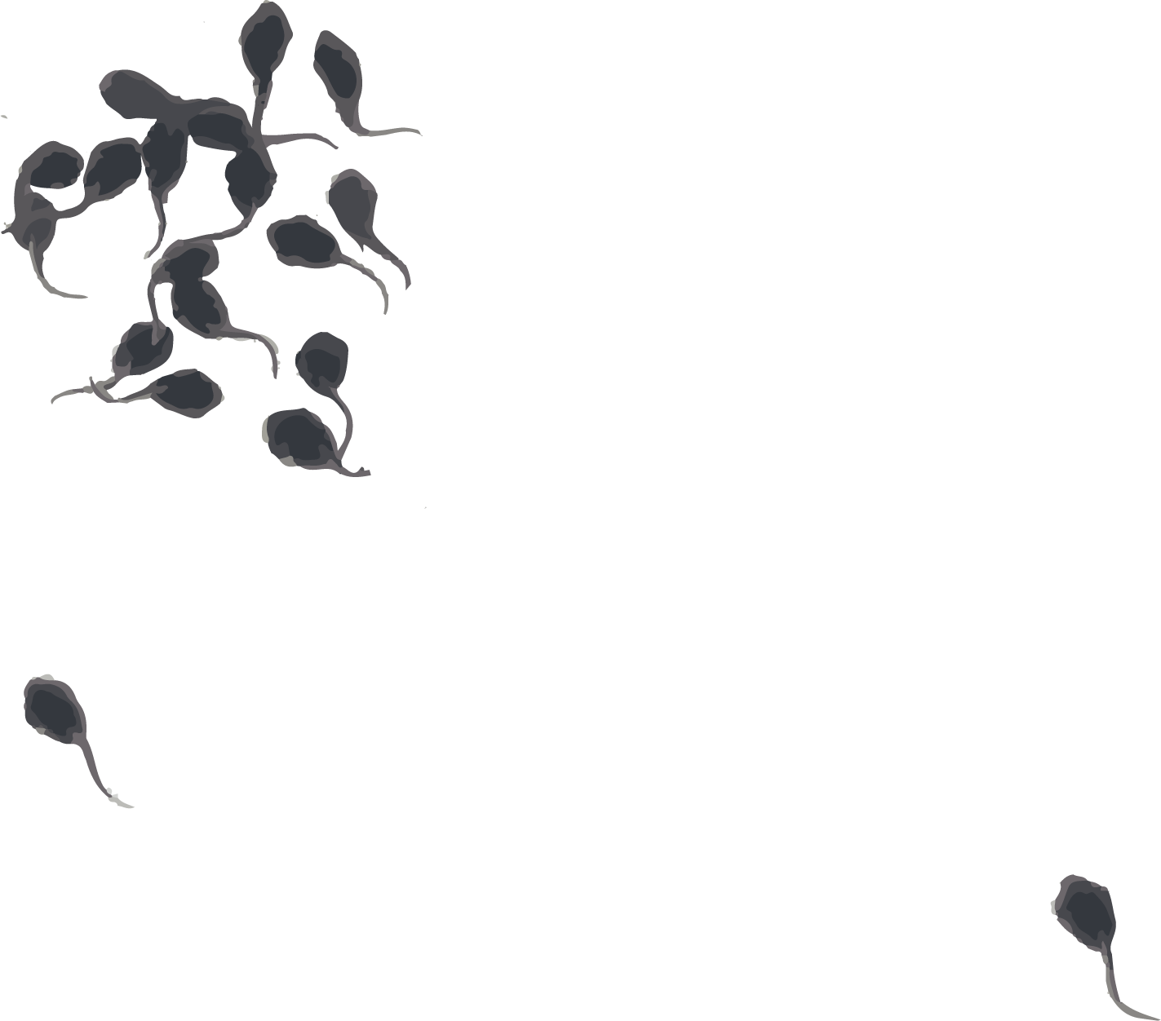
Features of cane toads (cont)
Life cycle
spawn is laid in long strings of transparent jelly enclosing double rows of black eggs
spawn tangles in dense dark masses around water plants, and hangs in ropy strands if picked up
tadpoles are shiny black on top and have a plain dark belly and a short thin tail. They are smaller (less than 3.5 cm long) than most native tadpoles and often gather in huge numbers in shallow water

Slide 34
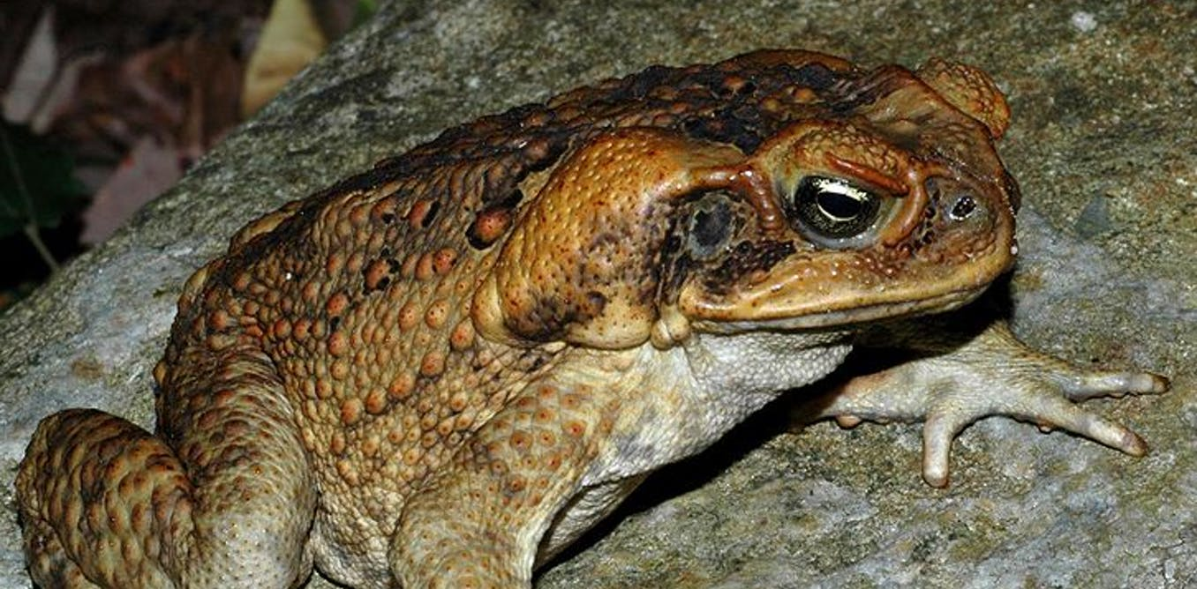
Is this a cane toad?
Does it have:
❑ Dry warty or leathery skin?
❑ Large glands behind its ears?
❑ Bony ridges over its eyes?
❑ Bright colours?
Is it a cane toad?
❑ Yes
❑ No

Slide 35
Is this a cane toad?
Does it have:
☑ Dry warty or leathery skin?
☑ Large glands behind its ears?
☑ Bony ridges over its eyes?
☒ Bright colours?
Is it a cane toad?
☑ Yes
❑ No
Cane toad!
This is a Cane Toad
(Rhinella marina)

Slide 36
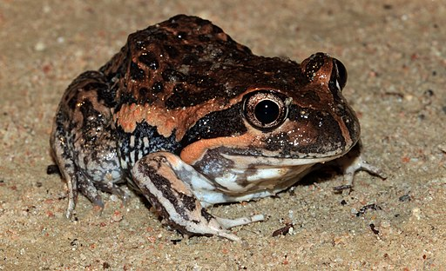
Is this a cane toad?
Does it have:
❑ Dry warty or leathery skin?
❑ Large glands behind its ears?
❑ Bony ridges over its eyes?
❑ Bright colours?
Is it a cane toad?
❑ Yes
❑ No

Slide 37
Is this a cane toad?
Not a cane toad
Does it have:
☒ Dry warty or leathery skin?
☒ Large glands behind its ears?
☒ Bony ridges over its eyes?
☑ Bright colours?
Is it a cane toad?
❑ Yes
☑ No
This is a native Eastern Pobblebonk Frog
(Limnodynastes dumerilii)

Slide 38
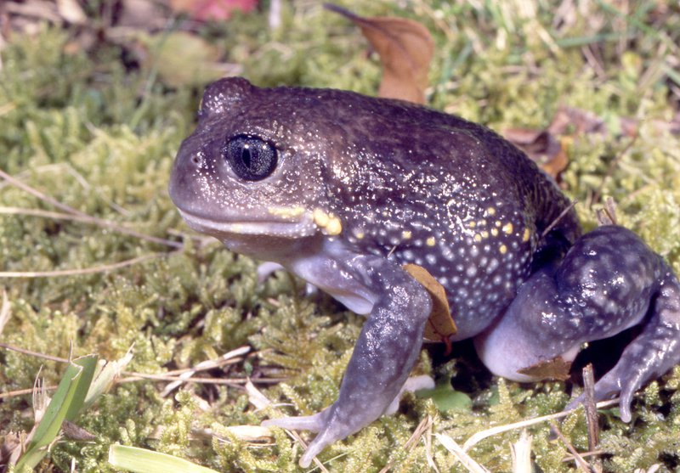
Is this a cane toad?
Does it have:
❑ Dry warty or leathery skin?
❑ Large glands behind its ears?
❑ Bony ridges over its eyes?
❑ Bright colours?
Is it a cane toad?
❑ Yes
❑ No

Slide 39
Is this a cane toad?
Not a cane toad
Does it have:
☒ Dry warty or leathery skin?
☒ Large glands behind its ears?
☒ Bony ridges over its eyes?
☑ Bright colours?
Is it a cane toad?
❑ Yes
☑ No
This is a native Giant Burrowing Frog
(Heleioporus australiacus)

Slide 40
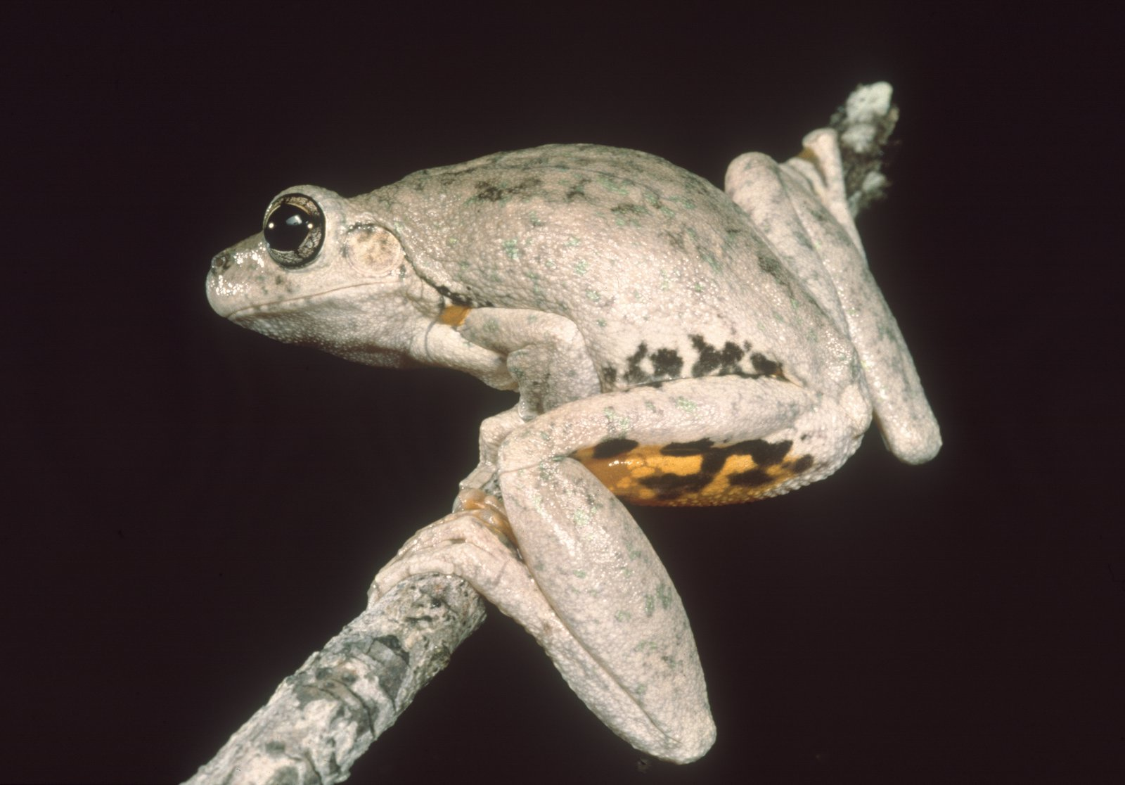
Is this a cane toad?
Does it have:
❑ Dry warty or leathery skin?
❑ Large glands behind its ears?
❑ Bony ridges over its eyes?
❑ Bright colours?
Is it a cane toad?
❑ Yes
❑ No

Slide 41
Is this a cane toad?
Not a cane toad
Does it have:
☒ Dry warty or leathery skin?
☒ Large glands behind its ears?
☒ Bony ridges over its eyes?
☑ Bright colours?
Is it a cane toad?
❑ Yes
☑ No
This is a native Peron’s Tree Frog
(Litoria peronii)

Slide 42
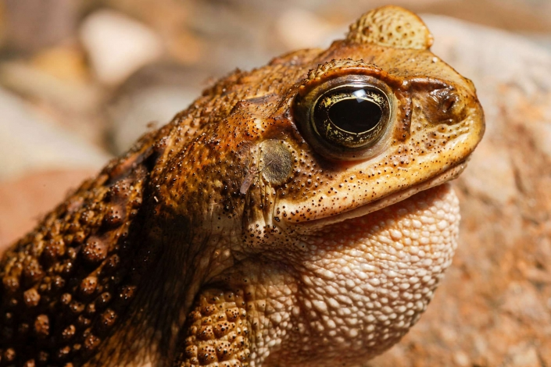
Is this a cane toad?
Does it have:
❑ Dry warty or leathery skin?
❑ Large glands behind its ears?
❑ Bony ridges over its eyes?
❑ Bright colours?
Is it a cane toad?
❑ Yes
❑ No

Slide 43
Is this a cane toad?
Does it have:
☑ Dry warty or leathery skin?
☑ Large glands behind its ears?
☑ Bony ridges over its eyes?
☒ Bright colours?
Is it a cane toad?
☑ Yes
❑ No
Cane toad!
This is a Cane Toad
(Rhinella marina)

Slide 44
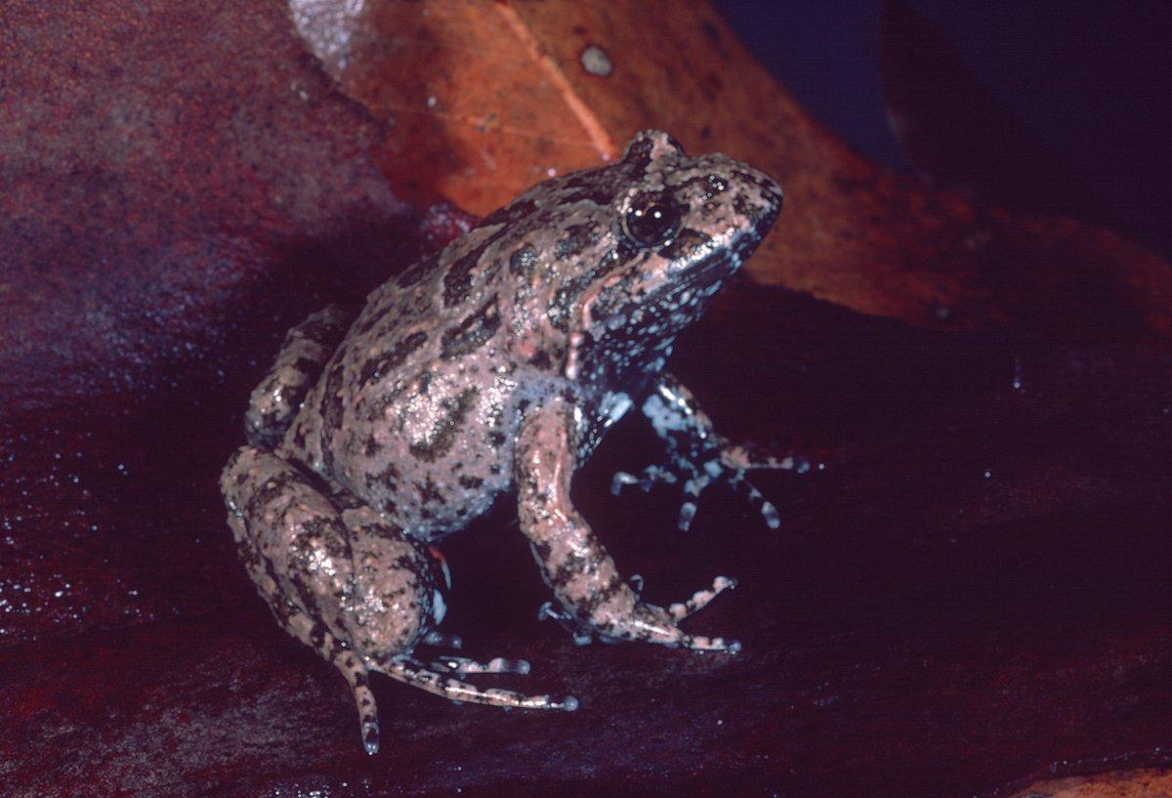
Is this a cane toad?
Does it have:
❑ Dry warty or leathery skin?
❑ Large glands behind its ears?
❑ Bony ridges over its eyes?
❑ Bright colours?
Is it a cane toad?
❑ Yes
❑ No

Slide 45
Is this a cane toad?
Not a cane toad
Does it have:
☒ Dry warty or leathery skin?
☒ Large glands behind its ears?
☒ Bony ridges over its eyes?
☒ Bright colours?
Is it a cane toad?
❑ Yes
☑ No
This is a native Tusked Frog
(Adelotus brevis)

Slide 46
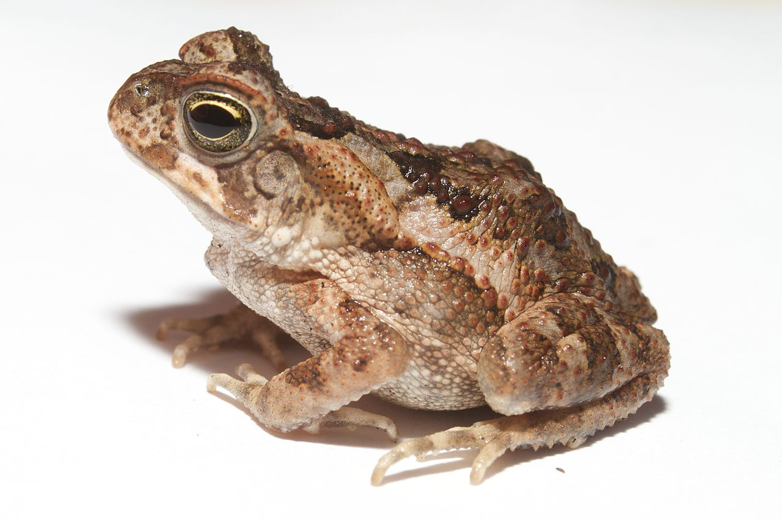
Is this a cane toad?
Does it have:
❑ Dry warty or leathery skin?
❑ Large glands behind its ears?
❑ Bony ridges over its eyes?
❑ Bright colours?
Is it a cane toad?
❑ Yes
❑ No

Slide 47
Is this a cane toad?
Does it have:
☑ Dry warty or leathery skin?
☑ Large glands behind its ears?
☑ Bony ridges over its eyes?
☒ Bright colours?
Is it a cane toad?
☑ Yes
❑ No
Cane toad!
This is a Cane Toad
(Rhinella marina)

Slide 48
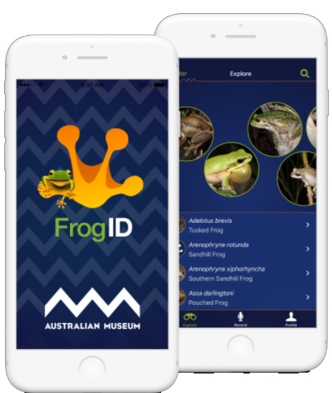
How did you go?
Learning the difference between Australian native frogs and cane toads will help you to help us slow the spread of cane toads and help protect Australian wildlife, the environment and our pets!
Check out these other native frogs that are often confused with cane toads in NSW:
Great barred frog
Ornate burrowing frog
Northern banjo frog
Common eastern froglet
Spotted marsh frog.
Learn about these native frogs on the Australian Museum’s website at https://australian.museum/learn/animals/frogs/
Make sure you download their Frog ID app to help them track native frogs in backyards across Australia!

Slide 49
