Slide 1

Citrus Biosecurity
Lesson 3 | Fieldwork Planner

Slide 2

Insect Surveillance
Conduct a surveillance exercise to see what insects are out in the field.

Slide 3
Insect Surveillance
Sticky Traps
Yellow sticky traps will catch insects that fly through the crop attracted to the yellow colour.
Conduct a surveillance exercise to see what insects are out in the field.
Notes:
http://entomology.k-state.edu/extension/special-projects/potato-psyllid-survey/archive2010.html

Slide 4
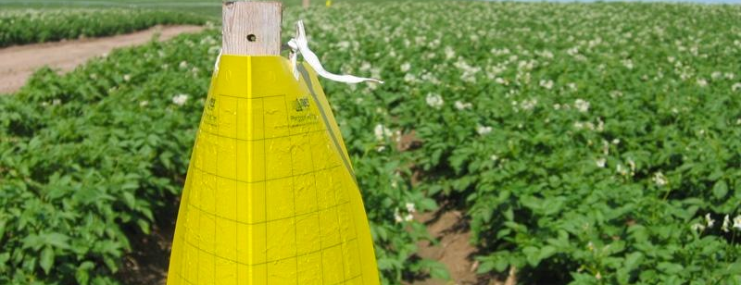
Sticky Traps
✔
Beneficial insects:
Lacewings and Parasitic Wasps
✘
Pest insects:
Aphids, Thrips and Light brown apple moth
Sticky trap equipment:
Two trap labels
One yellow sticky trap
One-two twist ties
String to suspend the bottom of the trap just below the leaves in an orchard crop
Latex gloves for each student handling traps
Three-four paper clips

Slide 5
Preparing Your Sticky Traps
1
Attach your set-up label to the trap with a paperclip
4
Hang just below the branches so it doesn’t get tangled
2
Collect and place the trap in your equipment box
5
Hang so long sides point up and down and face it into the breeze
3
Once in the field the sticky trap will be opened and hung in a tree with string, 2-5m in from the edge of the crop

Slide 6
Pitfall Traps
Pitfall traps catch ground dwelling invertebrates like beetles, ants, ground-dwelling spiders, cockroaches and thrips.
Photo: J. Wright, Queensland Museum |Used with permission: Queensland Museum © The State of Queensland (Queensland Museum) 2010-2014
Notes:
http://entomology.k-state.edu/extension/special-projects/potato-psyllid-survey/archive2010.html

Slide 7
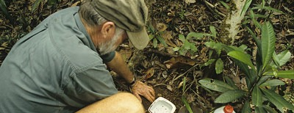
Pitfall Trap Equipment
Two ice cream containers with lids
One clean meat tray large enough to cover the ice cream container
Preservative (water with a teaspoon of dishwashing detergent OR methylated spirits) enough to fill the ice cream container to about 3cm deep
Other equipment:
A trowel
Two-four tent pegs
A pair of scissors
Two-three specimen jars with lids
A fine sieve
Two trap labels

Slide 8
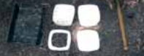
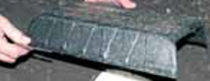
Preparing Your Pitfall Traps
Cut a hole in one of the ice-cream lids (leave an edge of 1-2cm)
Cut the short ends off the meat tray so it makes a tunnel and place everything in an equipment box

Slide 9
Installing Your Pitfall Traps
Dig a hole the size of the container
Place the lid with the hole on the container
Place a full lid on top of the lid with a hole
Place the container in the ground
Carefully remove the full lip from the top
Add the preservative and label the container
Place the meat container on top and secure with the tent pegs
DON’T get dirt in the trap!
Meat tray roof
Lid with the hole cut out
Top of container level with soil
Preservative (3cm deep)
Ice cream container

Slide 10
Trap Labels
Once collected, your insect specimens can only be useful for plant biosecurity purposes if the trap has a label.
Without a label the specimen has no scientific value.
Create labels out of plain paper cut to size and write on them with HB pencil.
Labels must include all of these details and be placed inside or on each trap.
Location: School Ag Farm
Date: 23/02/2016
Collector: Year 9, class 1
Crop type: Oranges
Growth stage: Flowering
Trap type: Pitfall trap

Slide 11
Measuring Weather Conditions
  Why? To better understand data especially in long studies that go for many years.
  If there are big differences seen in the data this could be related to a weather event such as wet weather or drought.
  Wind direction might also give clues to where flying insects are coming from.
Record with weather data recorder:
Temperature
Relative humidity
Wind speed & direction

Slide 12
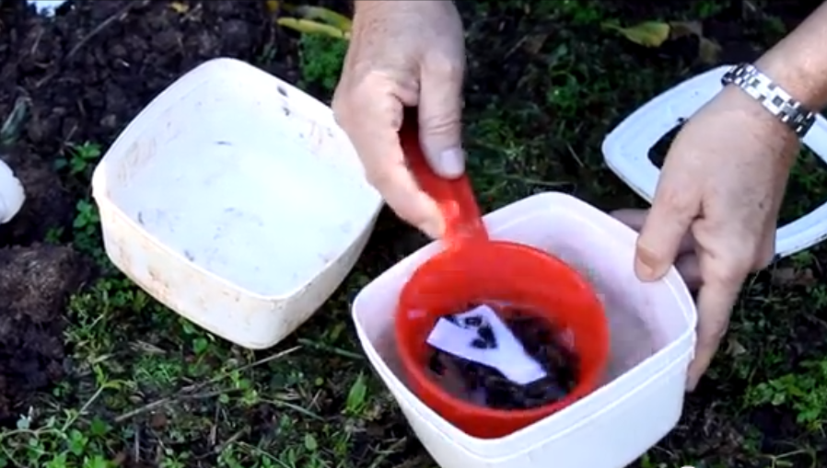
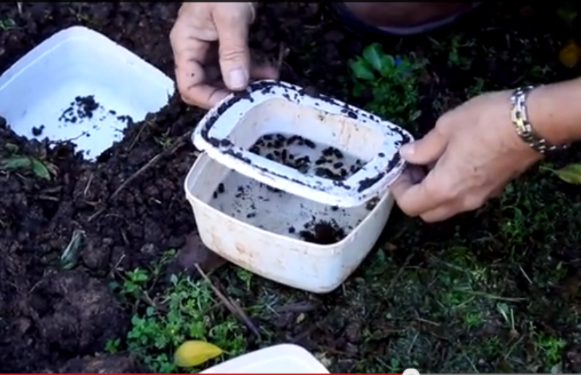
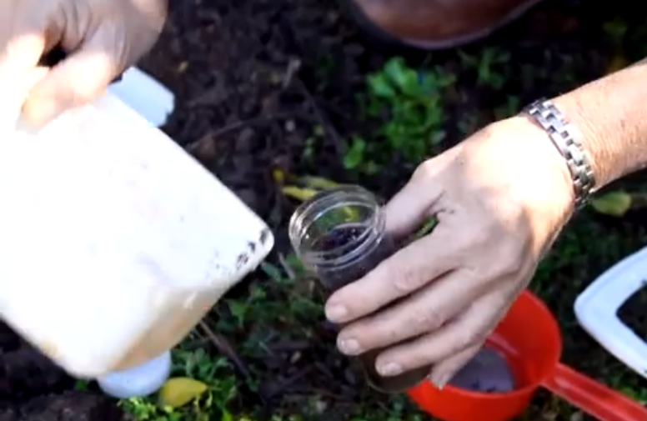
Collecting your pitfall traps
1
Lift the roof off the trap and carefully lift the container out of the ground.
2
Take the lid off making sure no dirt falls in the trap.
3
Add a label with the date of collection into the container.
4
Pour the contents of the trap through a fine mesh sieve to remove any large sticks and leaves.
5
Knock the sieve against a clean ice cream container to get all the specimens into the container.
6
Add a preservative to the insects and put the sample with the label into a specimen jar.

Slide 13
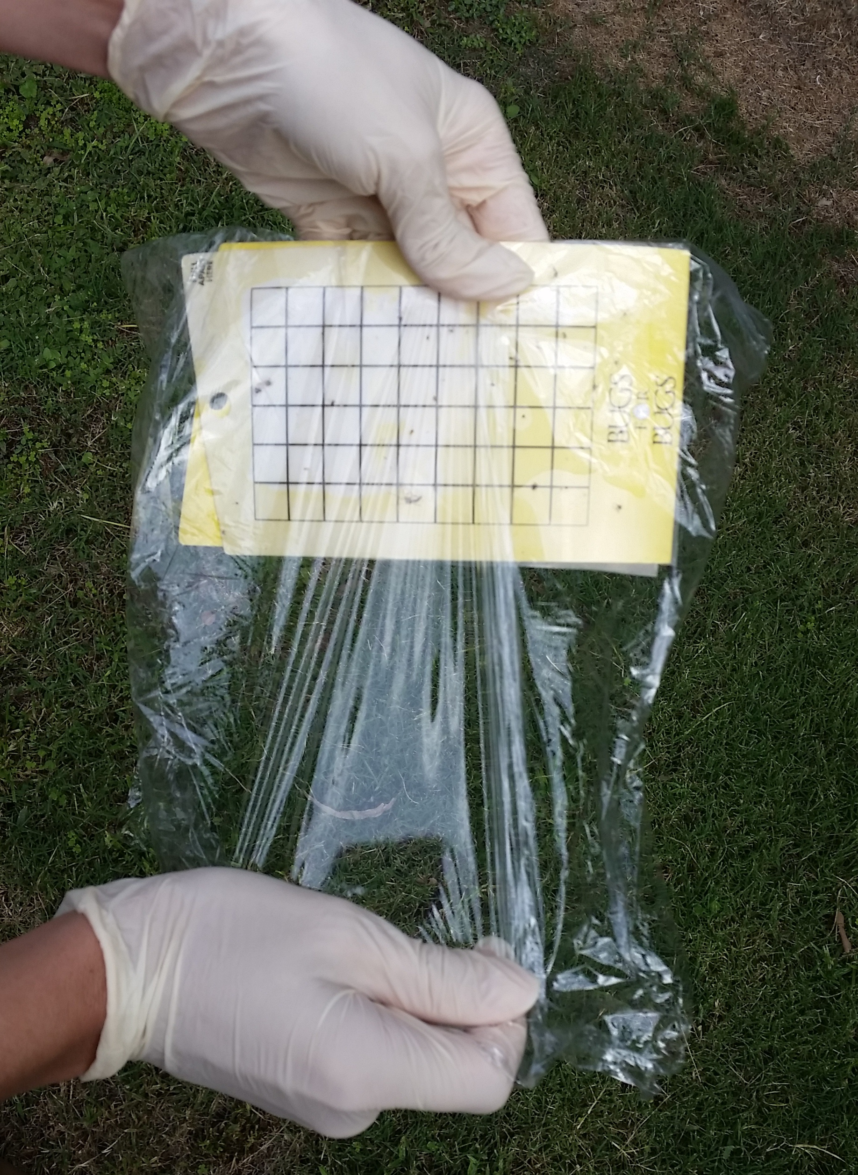
Collecting Your Sticky Traps
1
Attach your collection label to the trap with a paperclip.
2
Pick one student to put on disposable gloves. This person carefully removes the trap from the stake. Hold trap with both hands, at the non-sticky ends.
3
If the trap HAS A GRID - take a piece of cling wrap and carefully place it over the trap. Keep it as smooth as possible. Cut off any excess or fold behind.
4
If the trap HAS NO GRID - take a OHP transparency printed with a grid and place over the trap. DO NOT REMOVE the OHP/cling wrap once laid as it will pull the insects off the trap

Slide 14
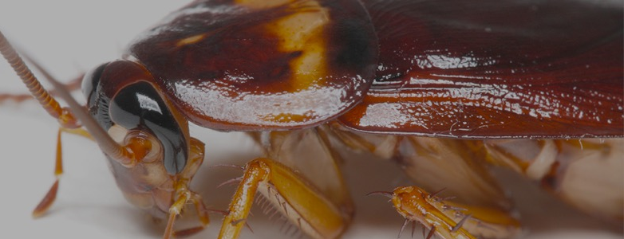
Equipment Checklist
Two pieces of plain paper
HB pencil
Scissors
GPS & weather data recorder
Camera
Twist ties
String
Disposable gloves
Preservative (detergent & water)
Trowel
Two ice cream containers & lids
Meat tray
2-4 tent pegs
Sticky trap
3-4 paper clips
Box to contain all equipment
OHP transparency with grid (or cling wrap)
Specimen bottles
Fine sieve
Long term preservative (ethanol)

