Slide 1
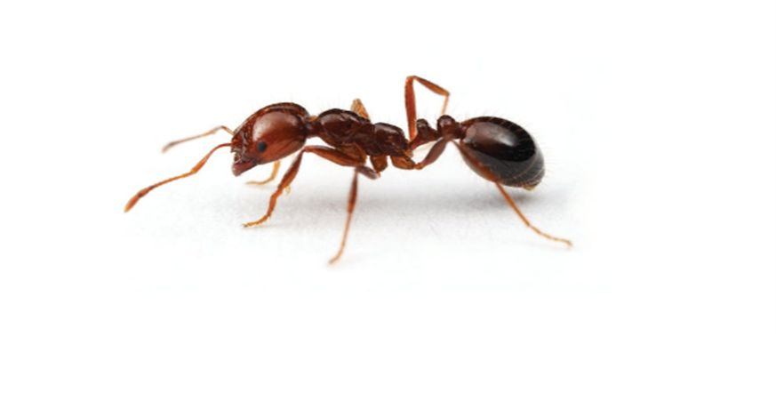
Red imported fire ants
NSW Department of Primary Industries Schools Program

Slide 2
What are Red imported fire ants?

Slide 3
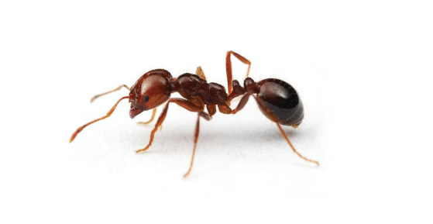
What are Red imported fire ants?
Red imported fire ants (fire ants) are invasive exotic ants that will cause serious social, economic, and environmental harm if they become established in Australia.

Slide 4
Where are Red imported fire ants in Australia?

Slide 5
Where are Red imported fire ants?
Fire ants are not native to Australia.
They are currently a pest infesting a large area of southeast Queensland with nests found very close to the NSW border.
On Saturday 25th November 2023 Red imported fire ants were found in South Murwillumbah in NSW.

Slide 6
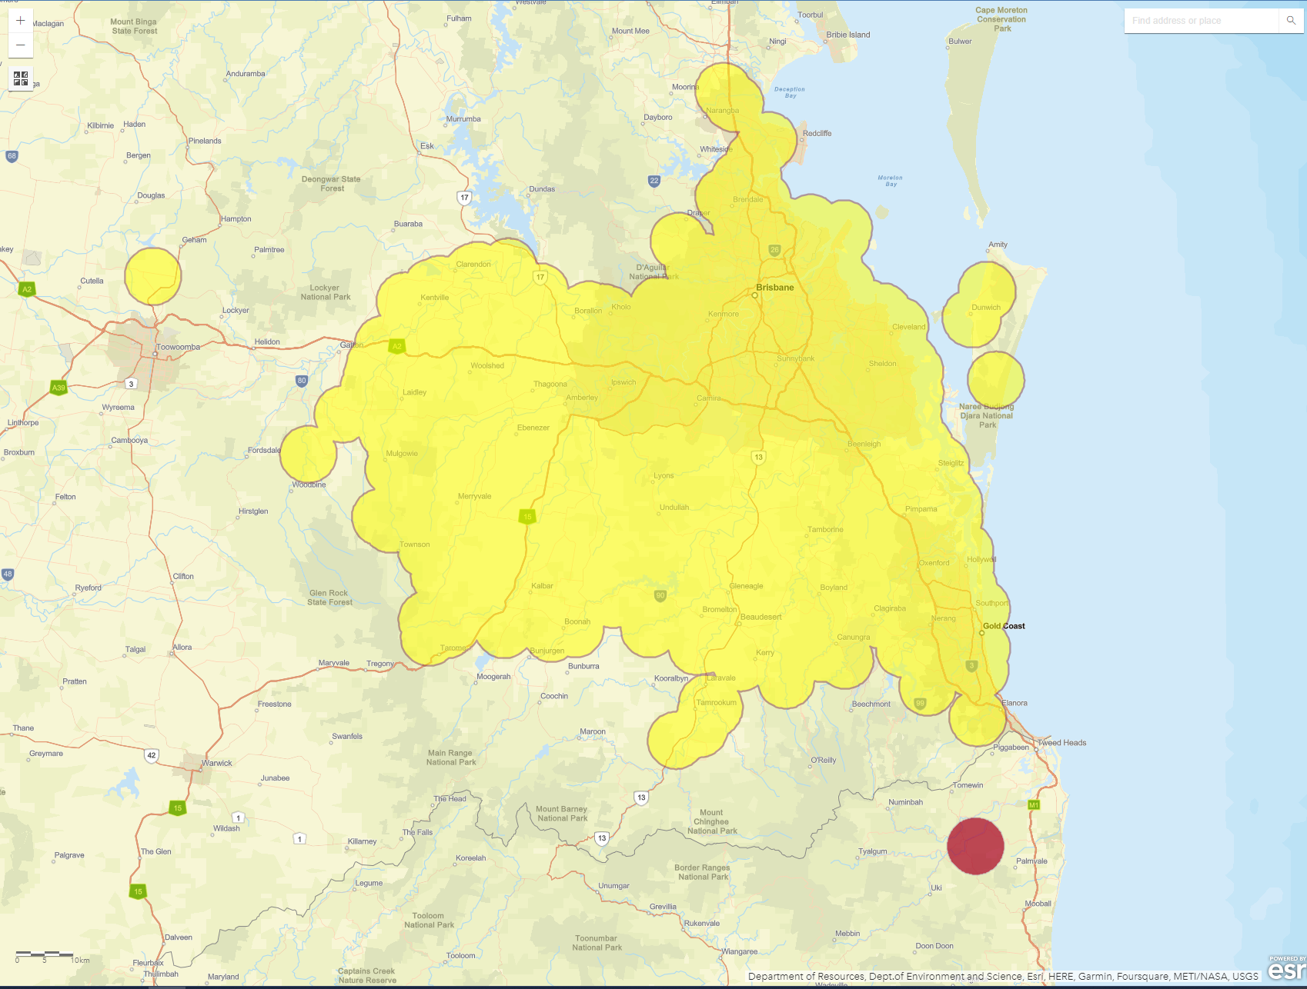

Slide 7
QUEENSLAND
South Murwillumbah
NSW
Border between Queensland & NSW

Slide 8
https://youtu.be/tVZYBonoF-c?si=shNrlaoqaXEerO5n

Slide 9
South Murwillumbah

Slide 10
Why are they a problem?
Health impacts
Environmental impacts
Economic impacts
Social and lifestyle impacts
They may be small, but fire ants can do a lot of damage

Slide 11
https://youtu.be/-8d2wUx6jDo?si=-NE2Hj_bixowk9fK

Slide 12
Why are they a problem? Human health
Fire ants are very aggressive and move quickly when disturbed.
Stings are very painful, lasting up to 1 hour. Multiple stings give a sensation the body is on fire.
Small pustules may form several hours after stinging and may become itchy and infected.
People prone to allergic reactions could experience severe symptoms
Stings are rarely life threatening, however seek medical advice if in doubt

Slide 13
Why are they a problem? Animal health
Fire ants also sting our pets, native fauna and livestock causing, pain, pustules and possible fatality to small, prone animals.
Seek veterinary advice if in doubt

Slide 14
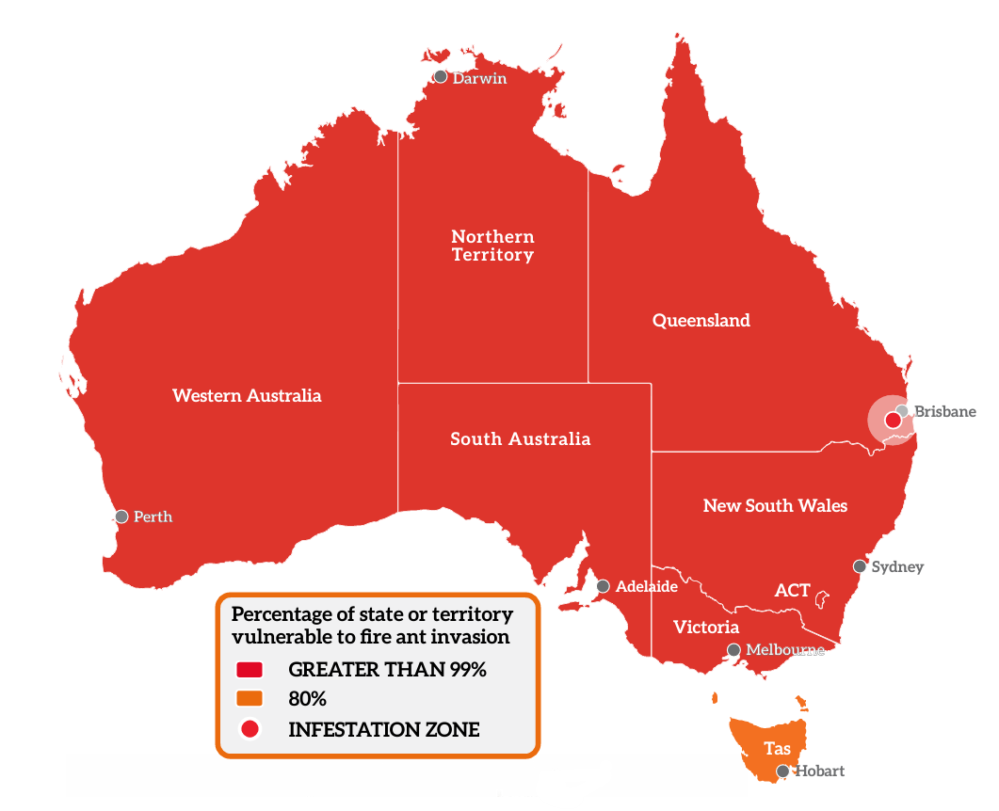
Why are they a problem? Environmental impacts
Fire ants have the potential to inhabit greater than 99% of Australia, which could have disastrous consequences for our environment.
Source: Invasive Species Council, Percentage of state or territory vulnerable to fire ant invasion, 2023

Slide 15
Why are they a problem? Environmental impacts
They can affect our environment as they potentially will:
feed on fauna that nests or feeds on the ground, including insects, spiders, lizards, frogs, birds and mammals
can displace and potentially eliminate some native species.
eat and damage seeds causing major ecosystem changes over time
predate or disturb the insects and animals that pollinate native plants, which may also cause long-term changes to the vegetation of our bushland areas

Slide 16
Why are they a problem? Social & lifestyle impacts
Fire ants can restrict everyday activities such as picnics and outdoor play, and sporting activities, because backyards, parks, playgrounds, beaches and sports grounds become unusable.
The impact of fire ants is not restricted to people. Pets and domestic animals can also be stung and injured and may have allergic reactions or be blinded by exposure to the venom.

Slide 17
Why are they a problem? Economic impacts
Fire ants have the potential to surpass the combined damage done each year by our worst pests: feral cats, wild dogs, foxes, camels, rabbits and cane toads.
They could affect our economy, markets and industries:
Tourism and lifestyle businesses and industry
Agriculture - destroying crops and livestock
Impacts overseas markets stopping our trade and travel with unaffected countries

Slide 18
How you can help
You have a Biosecurity duty to See, Report and Protect!

Slide 19
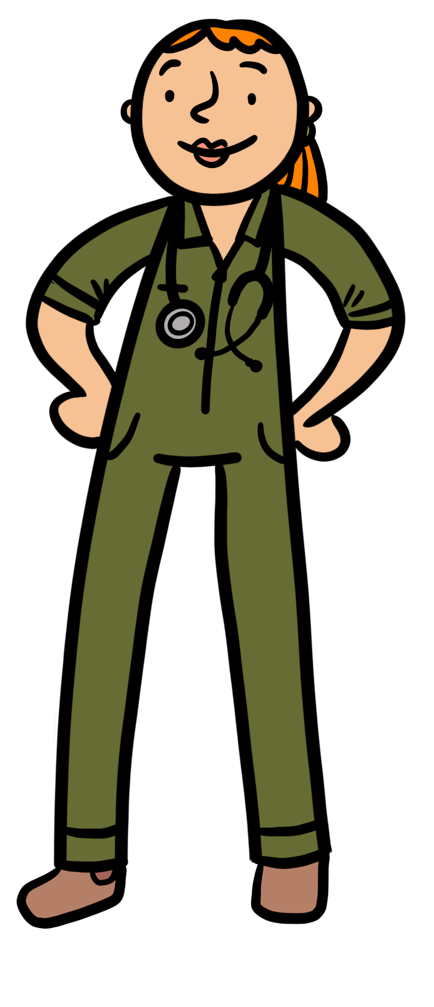
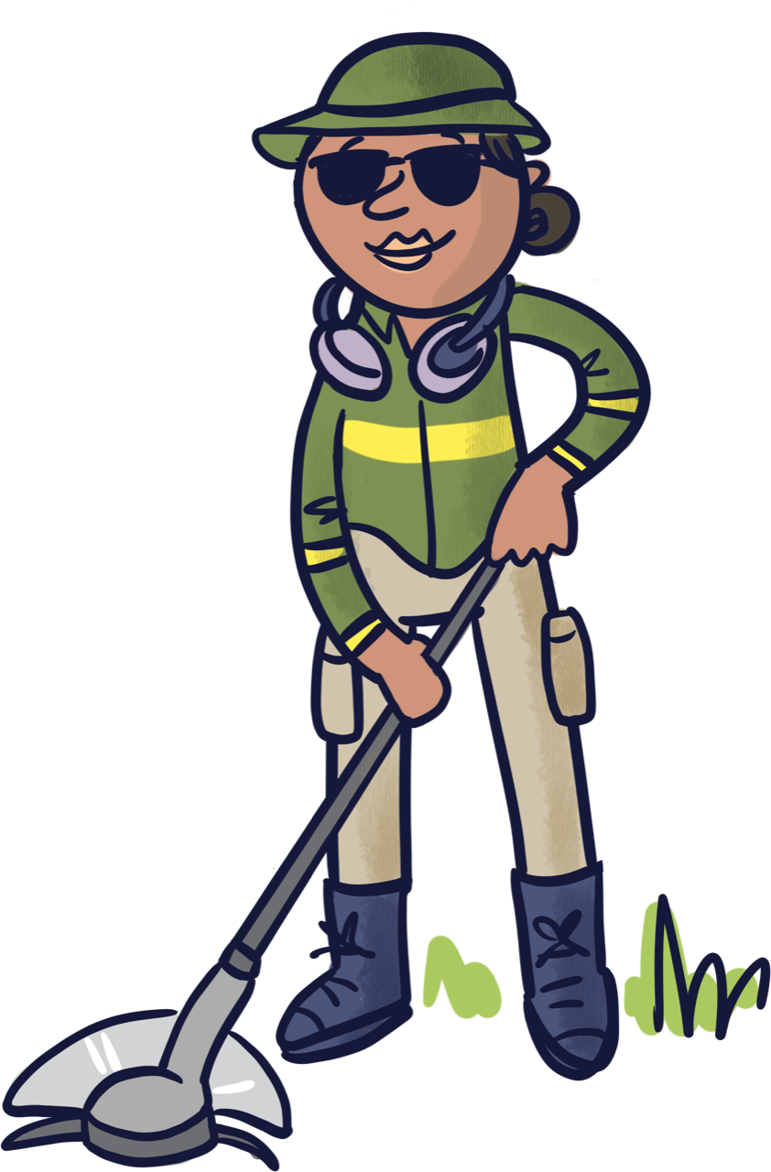
Biosecurity is a “shared responsibility”
What does that mean?
Everyone, no matter where you live in NSW, has a legal responsibility to make sure plant and animal pests, diseases and weeds are not introduced to, or allowed to spread, throughout our community or environment. This includes the school community.
Teachers
Local veterinarian
Principal
Trades people
Grounds keeper
Students and their families

Slide 20
https://youtu.be/_XL6QWRHZes?si=Iw2kVbRv4jWux2nX

Slide 21
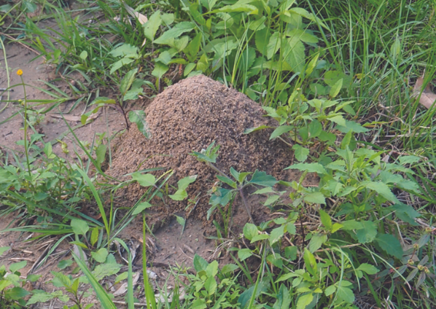
What to look for? Nests
Mounds or flattish patches of soil with no obvious entrance holes
Can be up to 40 cm high
More likely to be seen in sunny open areas such as lawns, school yards, parks, roadsides and golf courses
Occasionally found in rotten logs, along pavers and building walls.
Fire ant nest

Slide 22
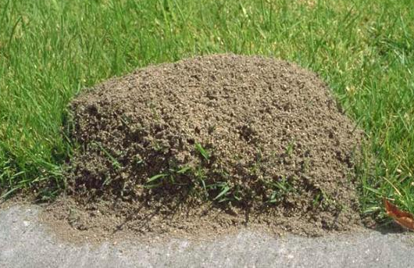
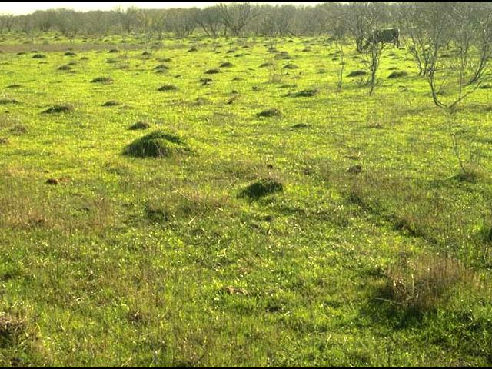
What to look for? Nests
Fire ant nest
Fire ant nests in a paddock
Source: Department of Primary Industries and Regional Development Western Australia, Red imported fire ant mounds, 2023,

Slide 23
https://youtu.be/GKbxnpvJkS8

Slide 24
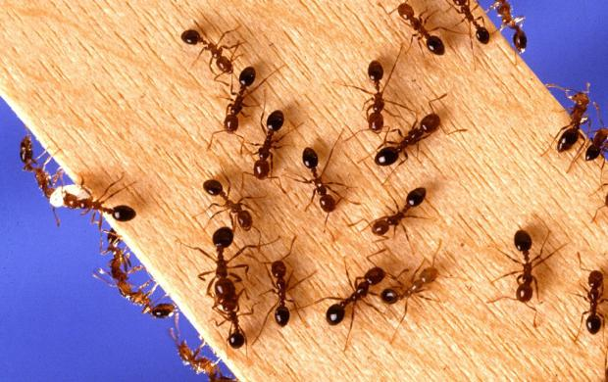
What do they look like? Size
Fire ants are 2 - 6 mm long with a range of sizes in one nest
Source: Department of Primary Industries and Regional Development, Western Australia, Red imported fire ant size range, 2023,

Slide 25
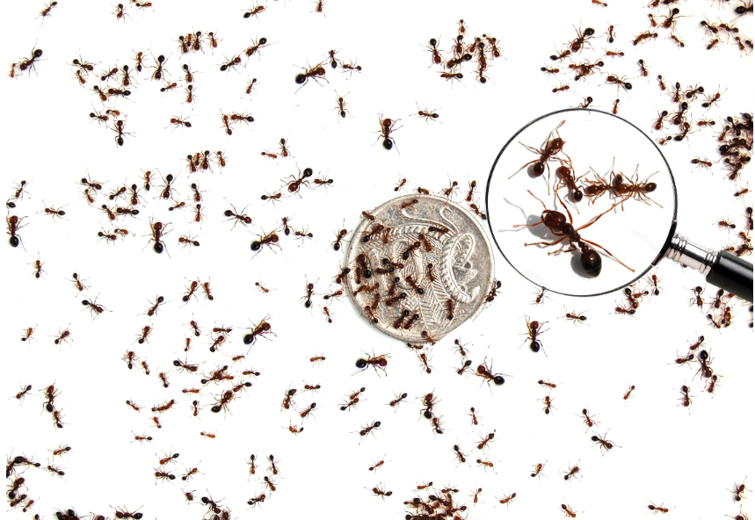
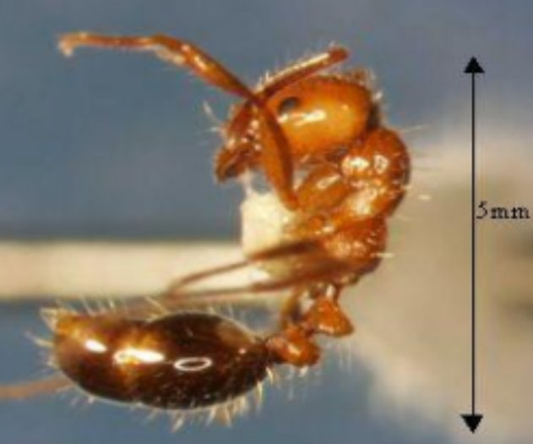
What do they look like? Colour
Dark reddish-brown in colour
Darker brown-black abdomen

Slide 26
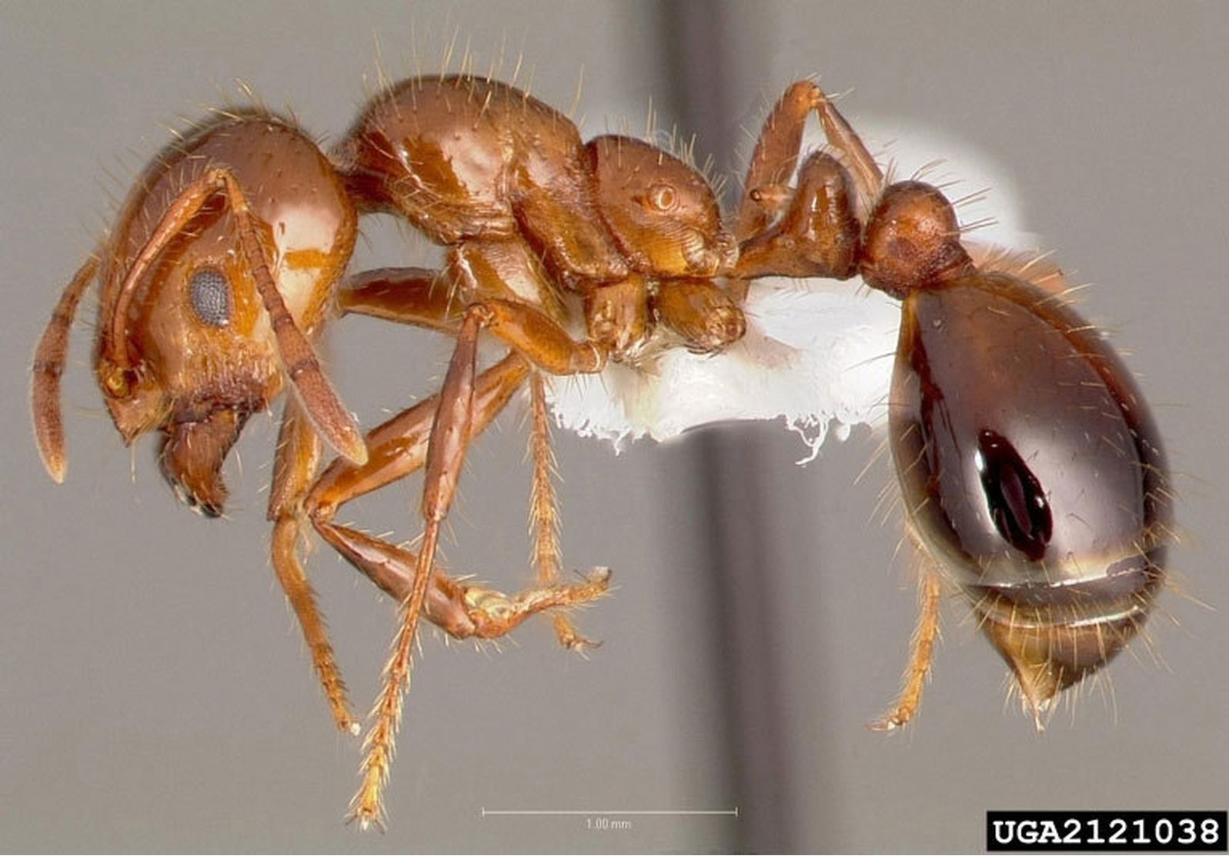
What do they look like? Shape
Waist section has 2 segments
Source: Invasive Species Council, Preserved fire ant, 2017

Slide 27
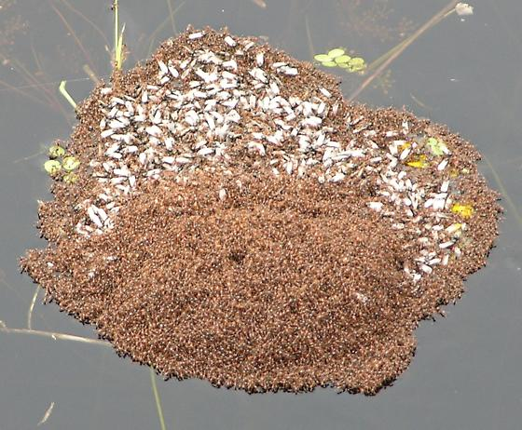
How do they spread?
Fire ants can fly up to 2 km, form rafts to float on water, and travel over or under the ground.
They can be moved long distances in carrier materials such as hay, turf, organic mulch and manure, soil, potted plants and agricultural equipment and machinery.
Source: BugGuide.NET, Solenopsis invicta, 2005

Slide 28
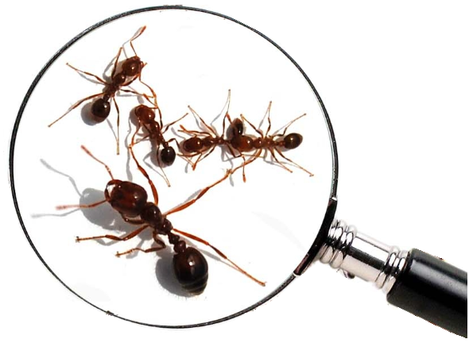
I think I’ve found Red imported fire ants - what should I do?

Slide 29
Step 1
DO NOT touch the ants or their nest with any part of your body as there is a high chance of being severely stung.

Slide 30
Step 2
DO NOT disturb or treat the infestation by yourself as this can cause the ants to move and spread or swarm and sting.

Slide 31
Step 3
DO NOT spray the nest with insect spray - this won't kill the whole nest and will cause the ants to swarm and become aggressive.

Slide 32
Step 4
ONLY IF it is safe, take some photos.
If you can only see a ‘furry looking’ nest,
DO NOT touch it and make sure you don’t get too close.

Slide 33
Step 5
Keep your camera still.
Use the zoom on your camera to get a close-up image while keeping a safe distance.
Put an object like a coin or a key in the photo for a size comparison if you see ants.

Slide 34
Step 6
Call 1800 680 244
for any suspicious sightings
OR send your photos using our online form at:
https://www.dpi.nsw.gov.au/biosecurity/forms/report-exotic-ants

