Slide 1
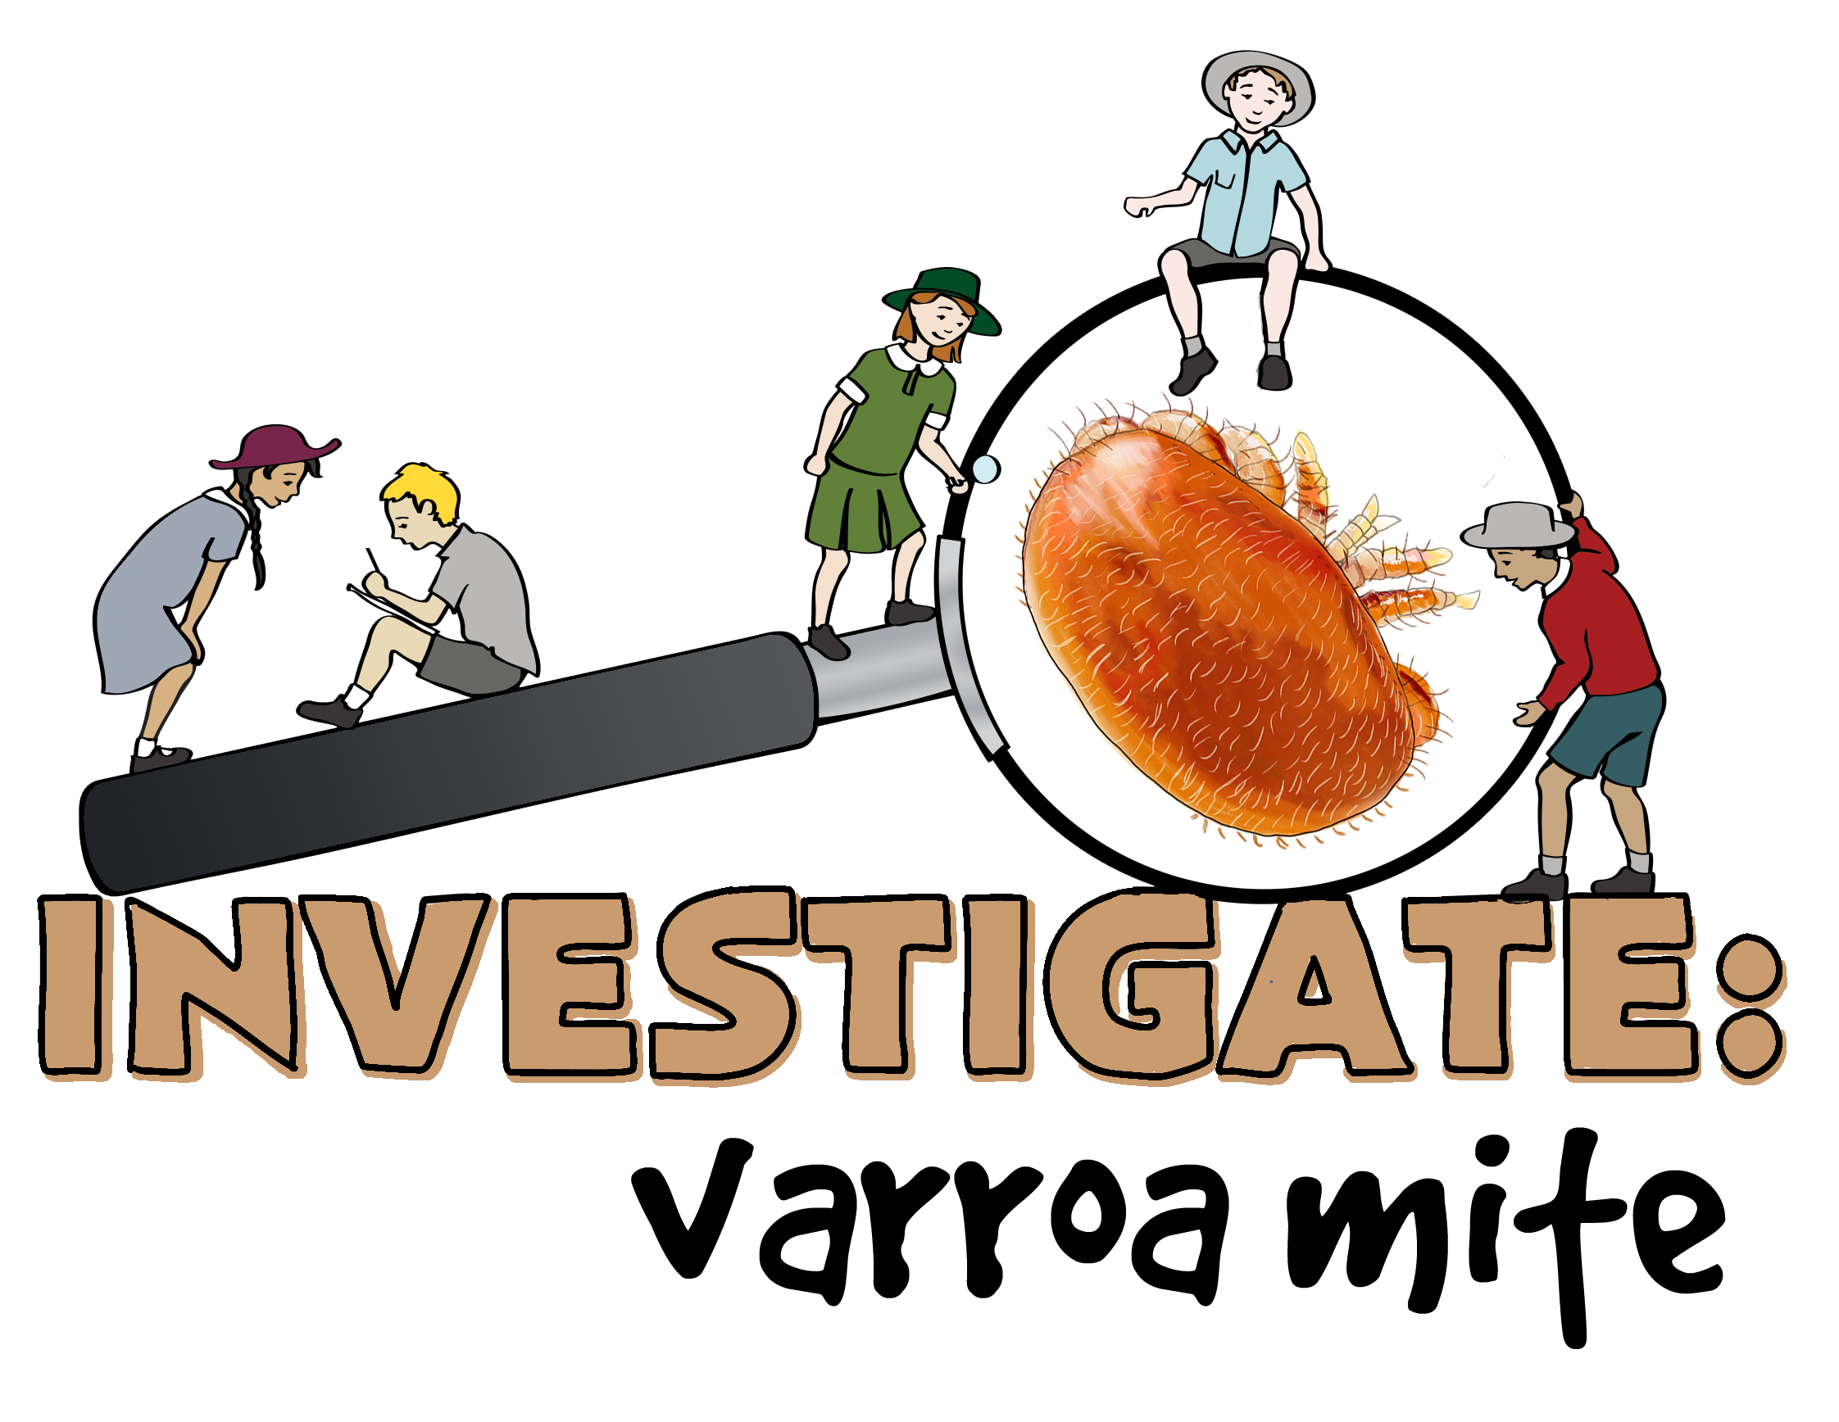
Version date: April 2024

Slide 2
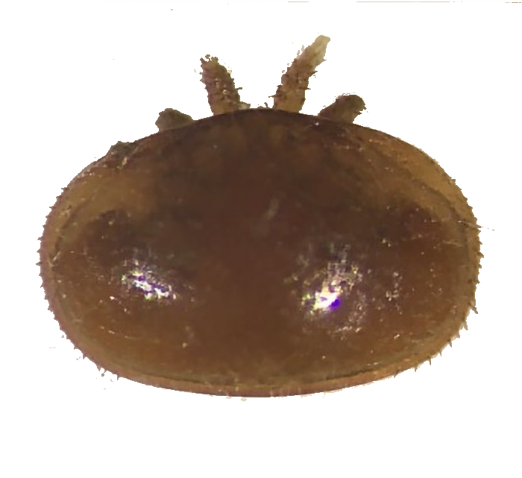
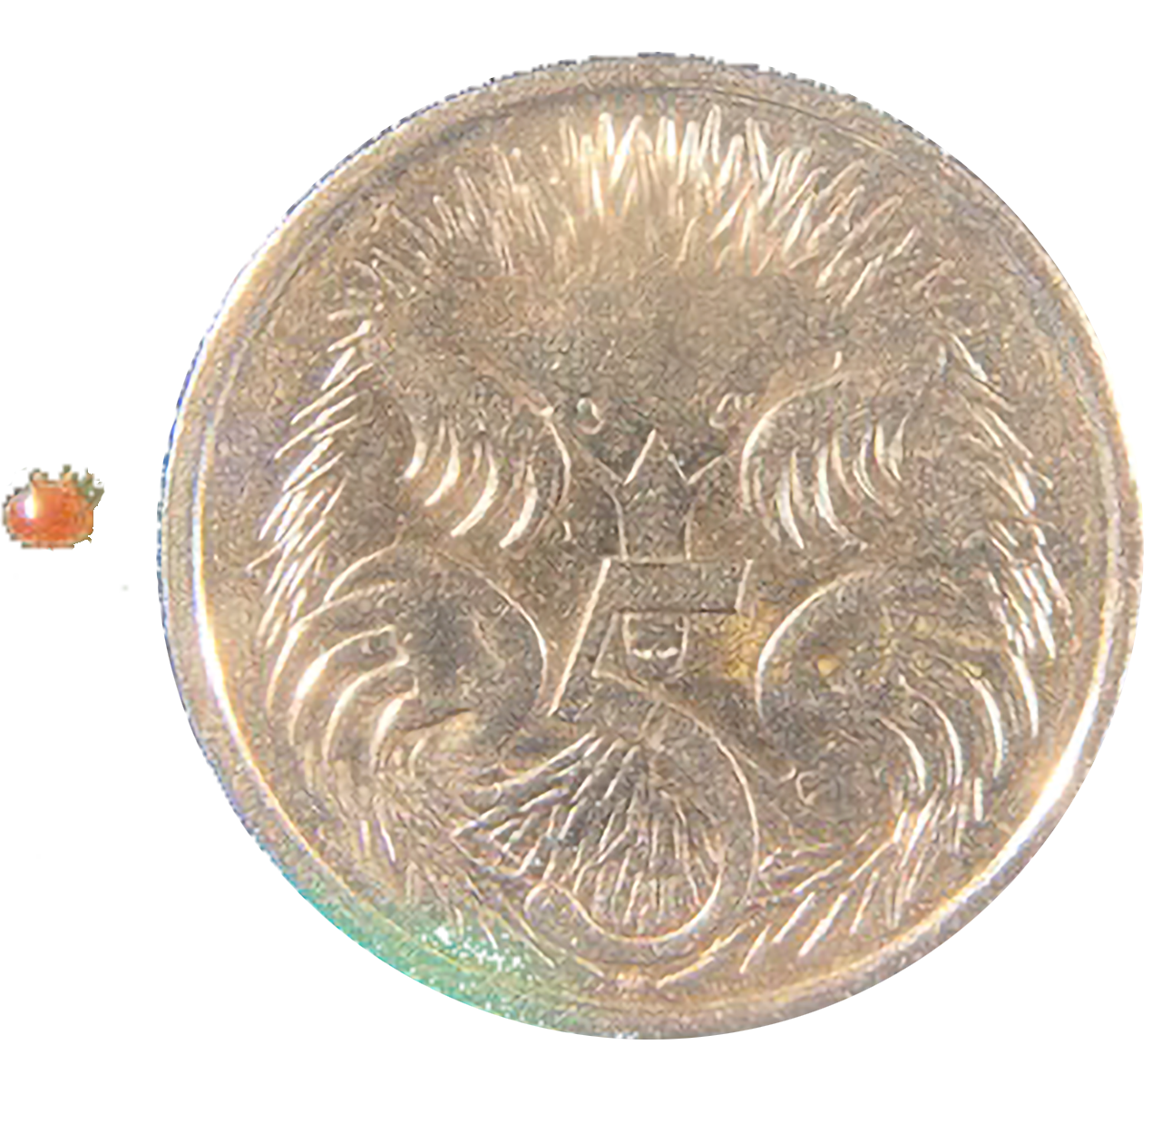
What is VARROA mite?
Varroa mite is the most serious pest of honey bees around the world.
The mite is a tiny insect that if left untreated can kill entire bee colonies.

Slide 3
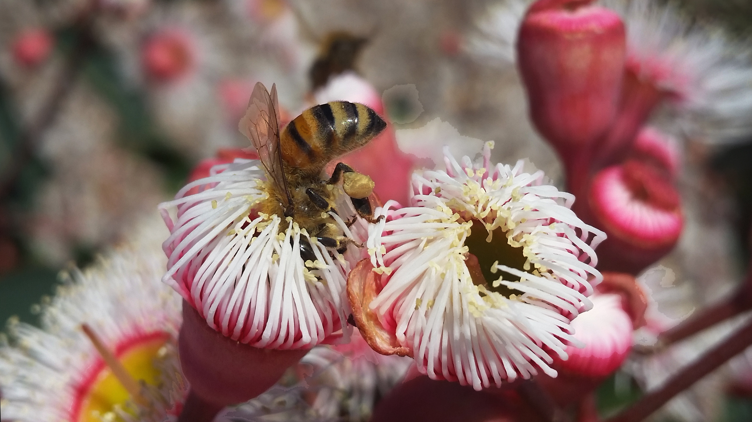
Why is it a problem?
Bees play a vital part in our ability to produce food. As one of the most important pollinators, without bees pollinating our fruit trees and crops we would be severely limited in the amount of fruit and seed we can produce.

Slide 4
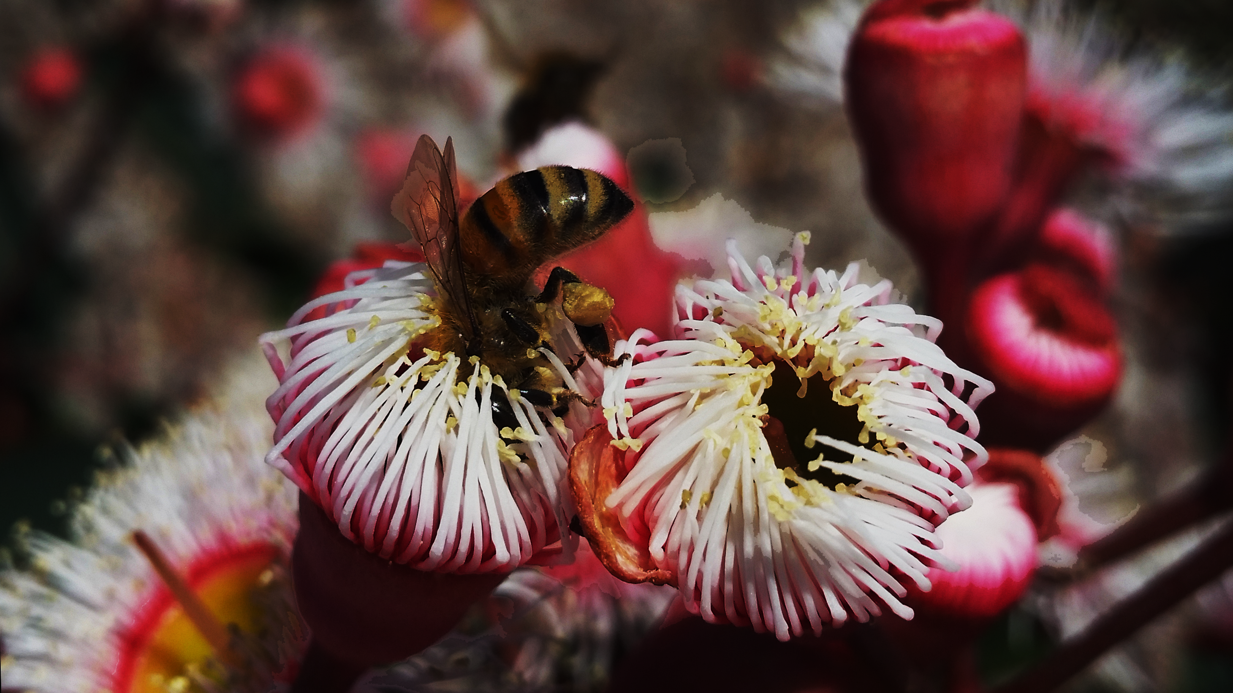
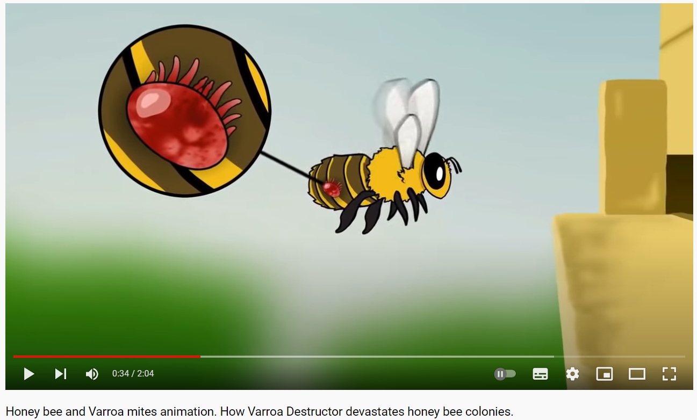
Watch this animation on youtube
Video link:
https://youtu.be/h-wDgd5yURo

Slide 5
An insect that can kill whole bee colonies can drastically reduce the number of bees, reducing the amount of pollination and therefore reducing the amount of fruit and seed plants can produce.

Slide 6
what happened in Newcastle?
Varroa mite were detected in sentinel hives in the Port of Newcastle.
Sentinel hives are hives that are placed in areas where invasive species are likely to arrive. Ports and freight storage areas for example.

Slide 7
what happened in Newcastle?
The sentinel hives are checked regularly because if invasive species arrive in freight, they would be expected to be present in the hives closest to the port first.
It’s an early warning system.

Slide 8
Incursion timeline
1
2
3
4
5
24 June 2022
Management of varroa mite in Australia continues
26 June 2022
August 2022
September 2023
February 2024
Varroa mite were detected in hives at the Port of Newcastle. An eradication plan was developed by the NSW Department of Primary Industries.
When varroa mite were discovered in another part of the state, the biosecurity zones were expanded to include that area and a statewide emergency order was put in place across NSW – restricting the movement of beehives anywhere in NSW.
As the perimeter of the incursion was established, the focus of the response turned to eradication of hives within the red zone, including wild European honeybee hives.
With new detections of varroa outside the established zones, it was decided that eradication of varroa mite was no longer achievable, and the focus turned to supporting the Australian honeybee industry in managing varroa.
A two-year Transition to Management plan was approved including training beekeepers in managing varroa in Australia, assessing the impact on pollination and ongoing surveillance.

Slide 9
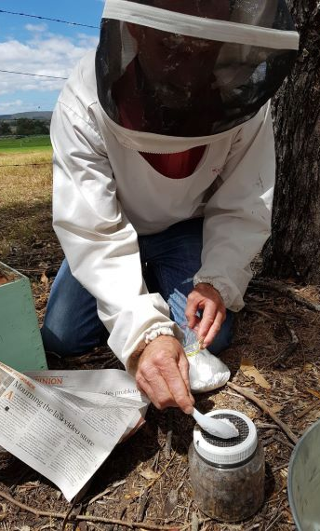
How do we know if Varroa mite are in a hive?
Beekeepers in NSW were asked to check their hives. Within the surveillance zones staff involved in the response checked hives including those outside of beekeepers’ hives – known as feral hives.
Checking hives involves either a sugar shake or an alcohol wash test.

Slide 10
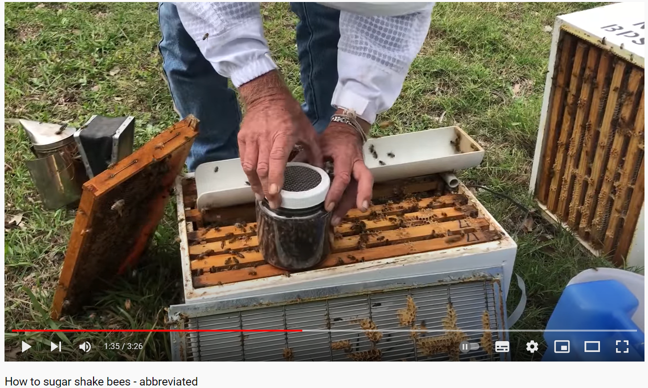
Sugar shake – video on youtube
Video address on YouTube:
https://youtu.be/MCH8H6yXKcU

Slide 11
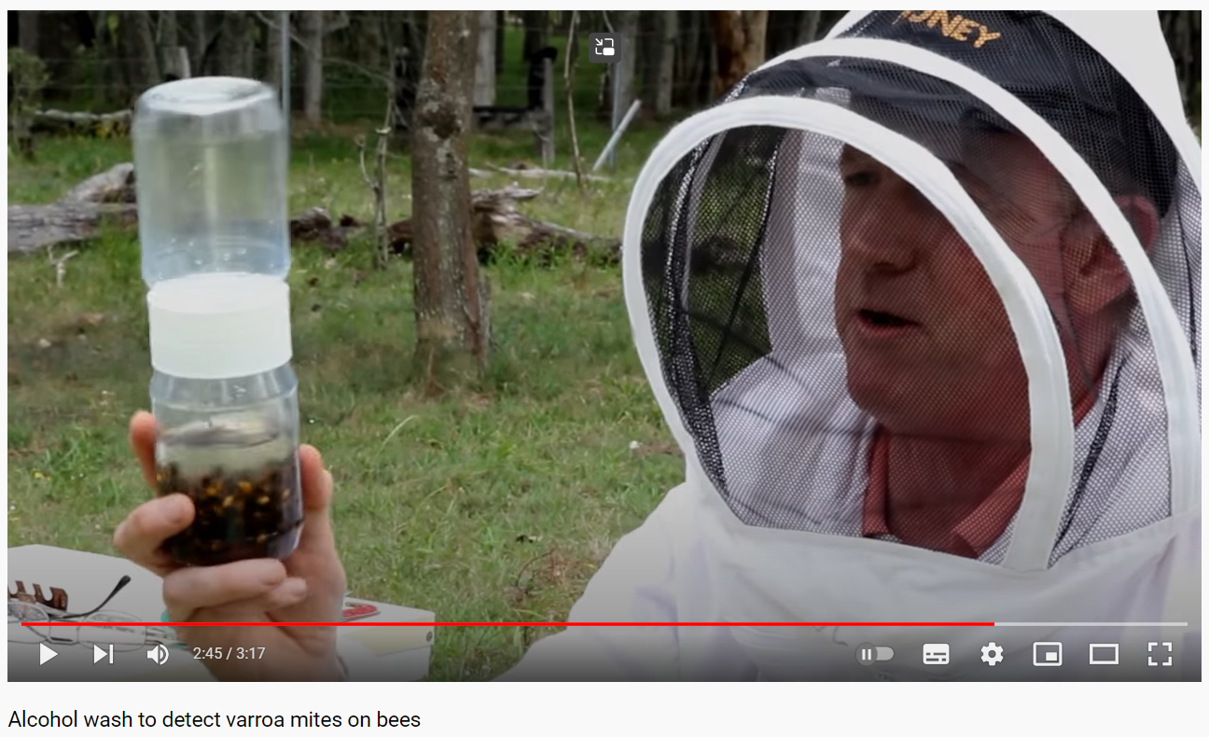
Alcohol wash - video on youtube
Video address on YouTube:
https://youtu.be/Ieq1-rMCWfc

Slide 12
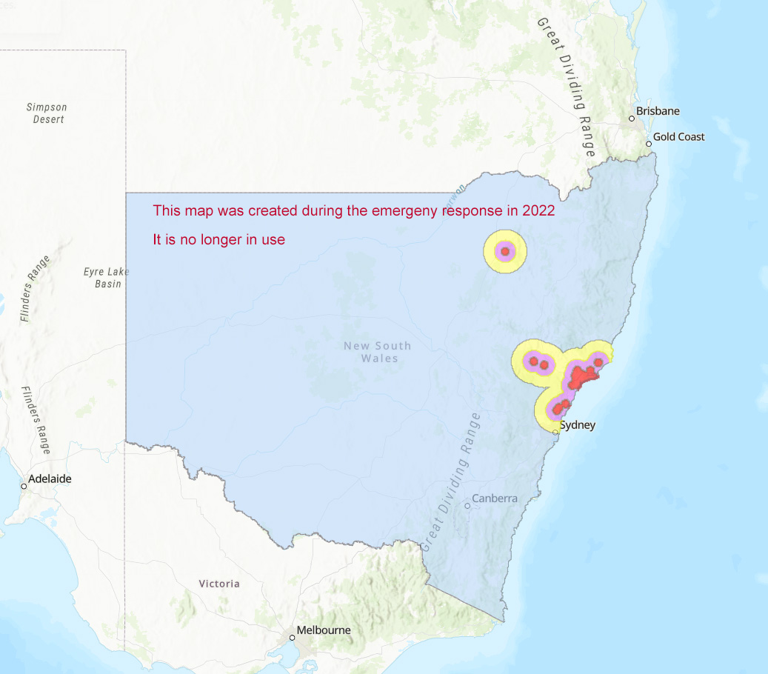
What did we do during the emergency response?
The discovery of varroa mites in Newcastle triggered a national biosecurity emergency response. The response established biosecurity zones (shown on the map) in an attempt to limit the spread of varroa mites.

Slide 13
What were the emergency zones?

Slide 14
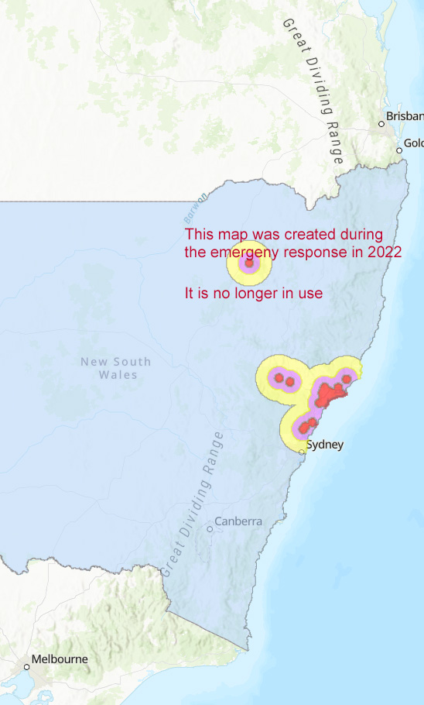
What were the emergency zones?
The red zones are a 10km radius from where varroa mite were detected. This was the eradication zone where honeybee hives were euthanised.
Varroa mite breed in honeybee colonies. Euthanising hives within this zone aimed at destroying any varroa mite that may have moved from hive to hive, infecting the colonies on the way. Destruction of the hives within this zone gave us the best chance of stopping this incursion.

Slide 15
What were the emergency zones?
The purple is the 25km surveillance zones, where officials monitored and inspected managed and feral honeybees to determine if varroa had moved beyond the 10km eradication zone.
The yellow was the 50km biosecurity zones where beekeepers were required to notify NSW DPI of the locations of their hives.

Slide 16
Why are the emergency zones no longer used?
In September 2023, when new detections outside the Biosecurity Zones were detected, the group managing the National emergency response agreed that eradication was no longer feasible – the infestation was more widespread than hoped and the resources to cover that area were not available.
Efforts turned to helping the beekeeping industry manage the impacts of the ongoing presence of varroa mites in Australia.

Slide 17
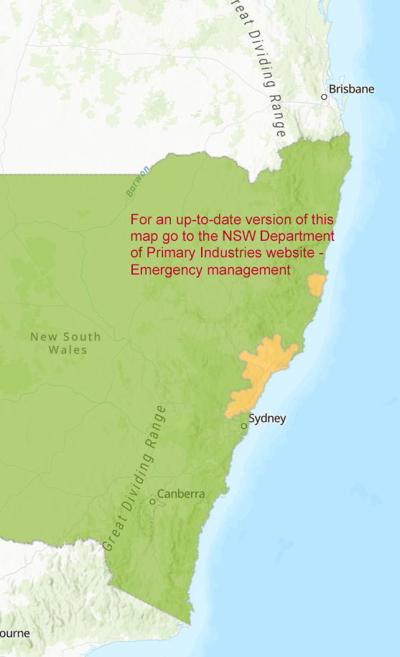
What does management of varroa mite mean ?
The Transition to Management plan aims to increase resilience and minimize ongoing impacts of varroa mite naturalisation across Australia’s bee and pollination-dependent industries.
Naturalisation is the process of a non-native species establishing and reproducing in an ecosystem. For varroa mite in Australia that means that it had been accepted that we cannot eradicate the pest, and the industries that rely on honeybees will need to manage its presence.
Photo: robdownunder on Flickr (https://flic.kr/p/oSZq2n) Licence

Slide 18
What does this mean for beekeepers ?
There are now two Varroa mite control zones in New South Wales. A Suppression Control Zone (green) and a Management Control Zone (yellow). Beekeepers are required to inspect hives, treat if varroa mite are present and submit a hive movement declaration before moving hives out of the Management Control Zone.
Photo: robdownunder on Flickr (https://flic.kr/p/oSZq2n) Licence

Slide 19
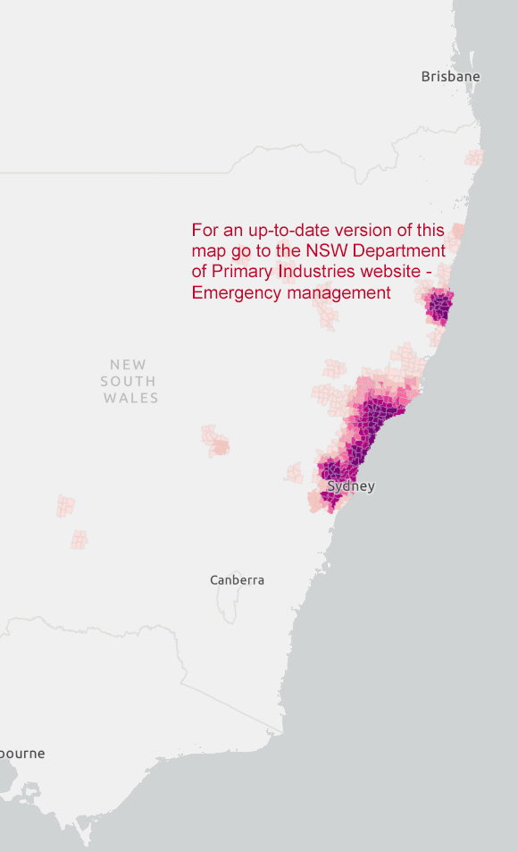
What does this mean for beekeepers?
All beekeepers are required to test their hives for varroa mite every 16 weeks. The results are reported to the NSW Department of Primary Industries who keep track of the spread of varroa mite and are supporting beekeepers in this transition.
The maps shown here shows were varroa mite have been detected and which areas have relatively high numbers.
Photo: robdownunder on Flickr (https://flic.kr/p/oSZq2n) Licence

Slide 20
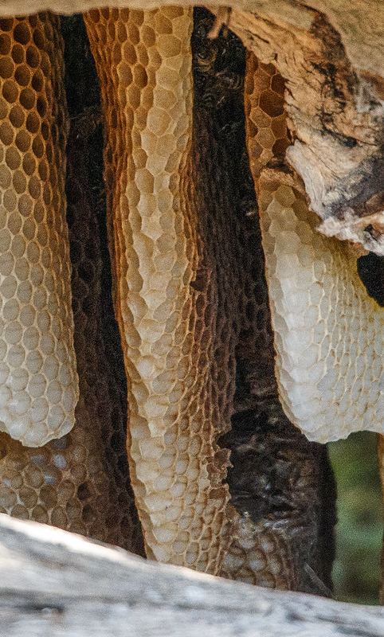
What next?
The ongoing impacts of varroa mite on Australian primary industries are being monitored. This includes impacts on the wellbeing of beekeepers and the public.
The Varroa Emergency Response Hotline, accessed via the Exotic Plant Pest Hotline 1800 084 881, is operational Monday to Friday 9am - 5pm.
and information about where to find support is available at https://www.dpi.nsw.gov.au/emergencies/biosecurity/current-situation/varroa-mite-emergency-response
Photo: robdownunder on Flickr (https://flic.kr/p/oSZq2n) Licence

Slide 21
Updates on the varroa mite presence in New South Wales are available at:
https://www.Dpi.Nsw.Gov.Au/emergencies/biosecurity/current-situation/varroa-mite-emergency-response
Thank you for sharing this important information about the varroa mite outbreak and the importance of biosecurity to Australian primary industries.

